Slide 1
​ This work is licensed under a Creative Commons Attribution 4.0 International License.​
The original author is me, Jos Polfliet. I have tried to link to original sources where I could. Should I have used material without (or with the wrong) attribution feel free to notify me at teaching@tc2.dev so I can fix it. I apologize in advance.

Slide 2
NATURAL LANGUAGE PROCESSING
January 2023 - JOS POLFLIET

Slide 3
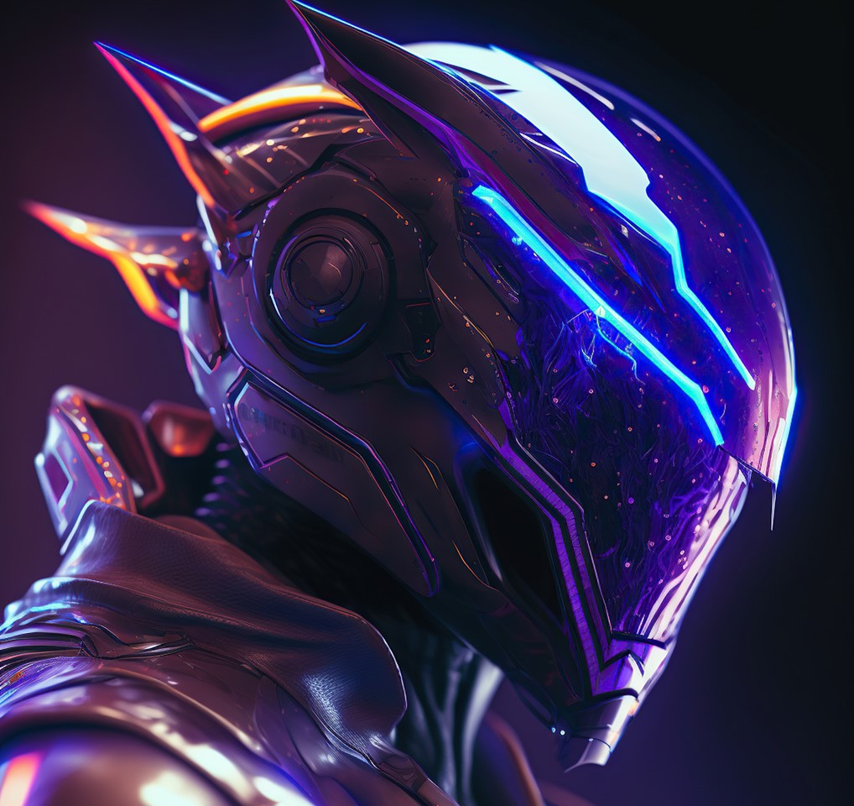

Lecture 1
MAI NLP

Slide 4
First, it’s your turn
SHORT INTRO
What’s your NLP level?
What do you want to learn from this course?
Notes:
9-9:10

Slide 5
Why NLP? HISTORY, IMPACT AND FUTURE
Read more and get inspired by Stanford CS224N: NLP with Deep Learning | Winter 2021 | Lecture 1 – Intro https://www.youtube.com/watch?v=rmVRLeJRkl4&t=1481s
Notes:
9:10

Slide 6
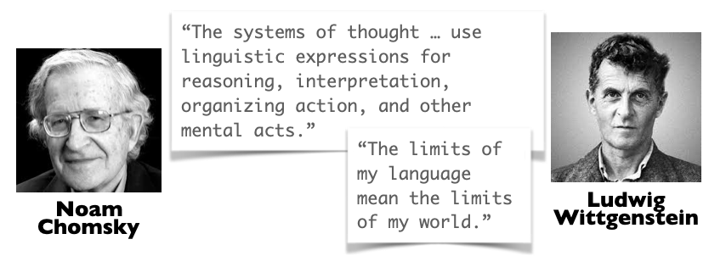
Source: https://twitter.com/ev_fedorenko/status/1554507967881482242

Slide 7

THE IMPORTANCE OF LANGUAGE
LANGUAGE IS LOGIC,
AND LOGIC IS LANGUAGE
Most people have an “Internal monologue” that guides (a part of) their thoughts. Some even think “100% narratively”
We will come back to “Transformers are universal computation blocks” later
Want to learn more?
https://plato.stanford.edu/entries/inner-speech/
https://twitter.com/sergeykarayev/status/1518677260236034050
Notes:
“Internal monologue” = “The voice inside your head”. 30-50% of people according
Homo Sapiens: the invention of language lead to fairy tales and being able to cooperate with people you don’t actually know due toyour common belief in fictions.

Slide 8
DISCUSSION
What exists that cannot be described in language?
Further reading by Jacob Browning and Yann Lecun https://www.noemamag.com/ai-and-the-limits-of-language/
Notes:
Language is a sort of “simplification” or “compression”. You can write down the music notes of a performance, but not the performance itself.
Feelings and poets
IKEA instructions: they don’t even use language!!
Hint of condescension or irritation in the way someone speaks to you

Slide 9
THE IMPORTANCE OF LANGUAGE
WHAT
I believe language is the basics of humanity, and therefore NLP is the most important topic in AI research
It's profoundly human
A chimpanzee can express "there are banana's there, let's eat", and "run away, there's a lion". But not complex thoughts and fictions.
Language is deeply personal
Just like it could well be that what I see as “red” might look different, I am never sure that the words I use will have the same meaning you think they do.
If we can't express it in language, does it even exist?
Can we justify human experiences that you can't describe in words? Maybe that is exactly what makes us human, being able to "feel" something like love, which poets have spent thousands of years to describe.
But isn't that a mute point, just like "consciousness": does it matter if an AI really feels something or just pretends too? Is the value innate to and required for the experience ? I also have no real way of knowing what other people "feel" or whether they are just "faking feelings", but does that matter to me as an observer?
Lots of existential and philosophical arguments possible I'm sure. E.g. Chinese room parable.
Written language is the biggest and most practical repository of knowledge by a huge margin. People’s memories, audio or video recordings don’t come close.
Want to learn more?
Book: Yuval Harari –Homo Sapiens
Notes:
Jos

Slide 10
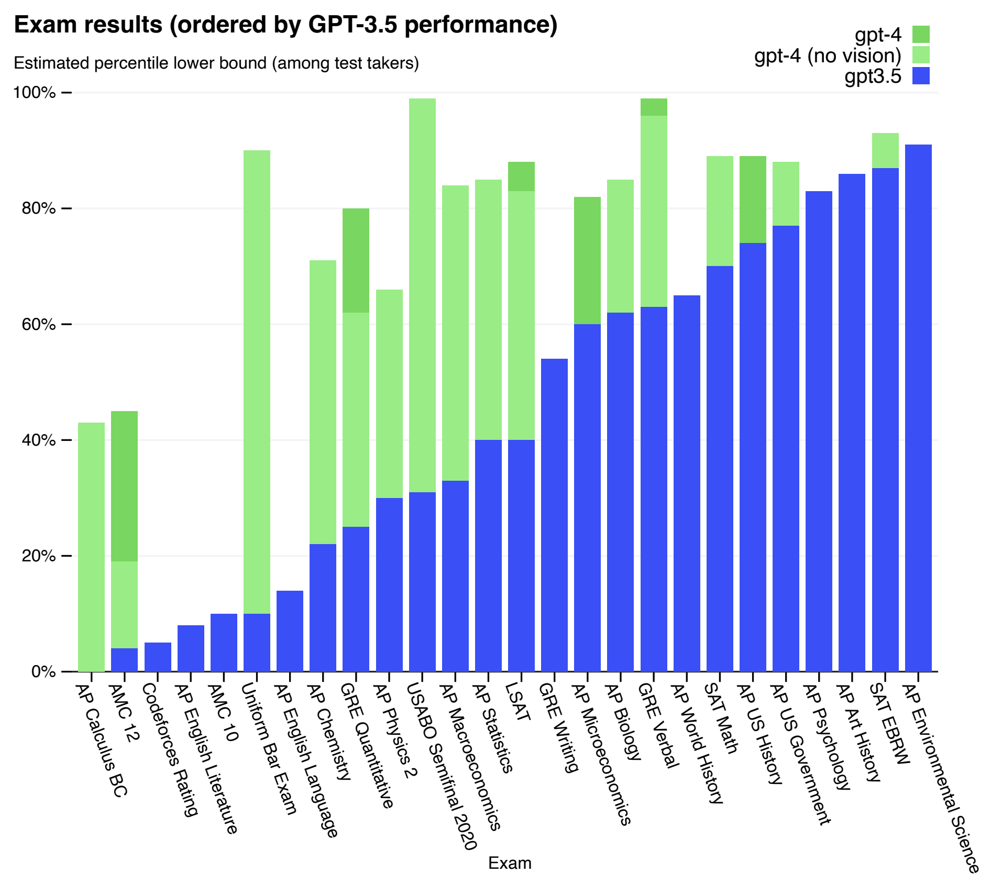
Why?
Large Language Models are the foundation for Artificial General Intelligence
Can simulate students, processors, new information, journalists, …
If your let it perform an IQ test, it has an estimate IQ of 83-130
Routinely get tricked into trying to destroy all of humanity after 24 hours, of course …
Notes:
Prompt – ask students what their last assignment was.

Slide 11
DISCUSSION
What other data sources that are non-language exist, and which knowledge would be captured in them?
Notes:
Blackboard exercises
Compare data sources
Accessibility
Standardisation
Availability
Computational power
List of data sources
Natural language as found on the internet, documents, …
Video’s of real human experiences
Emotions, innate human knowledge

Slide 12
THE IMPORTANCE OF LANGUAGE
Soon?
Scope X: Emotions, feelings and internal states
November 2023
November 2022
Scope 5: Interacting with the world
Scope 4: The world of video and audio
Scope 3: The written world on the internet and in books
Scope 2: Invisible, structured written data
Scope 1: Structured, numeric data
Notes:
Build up slide together

Slide 13
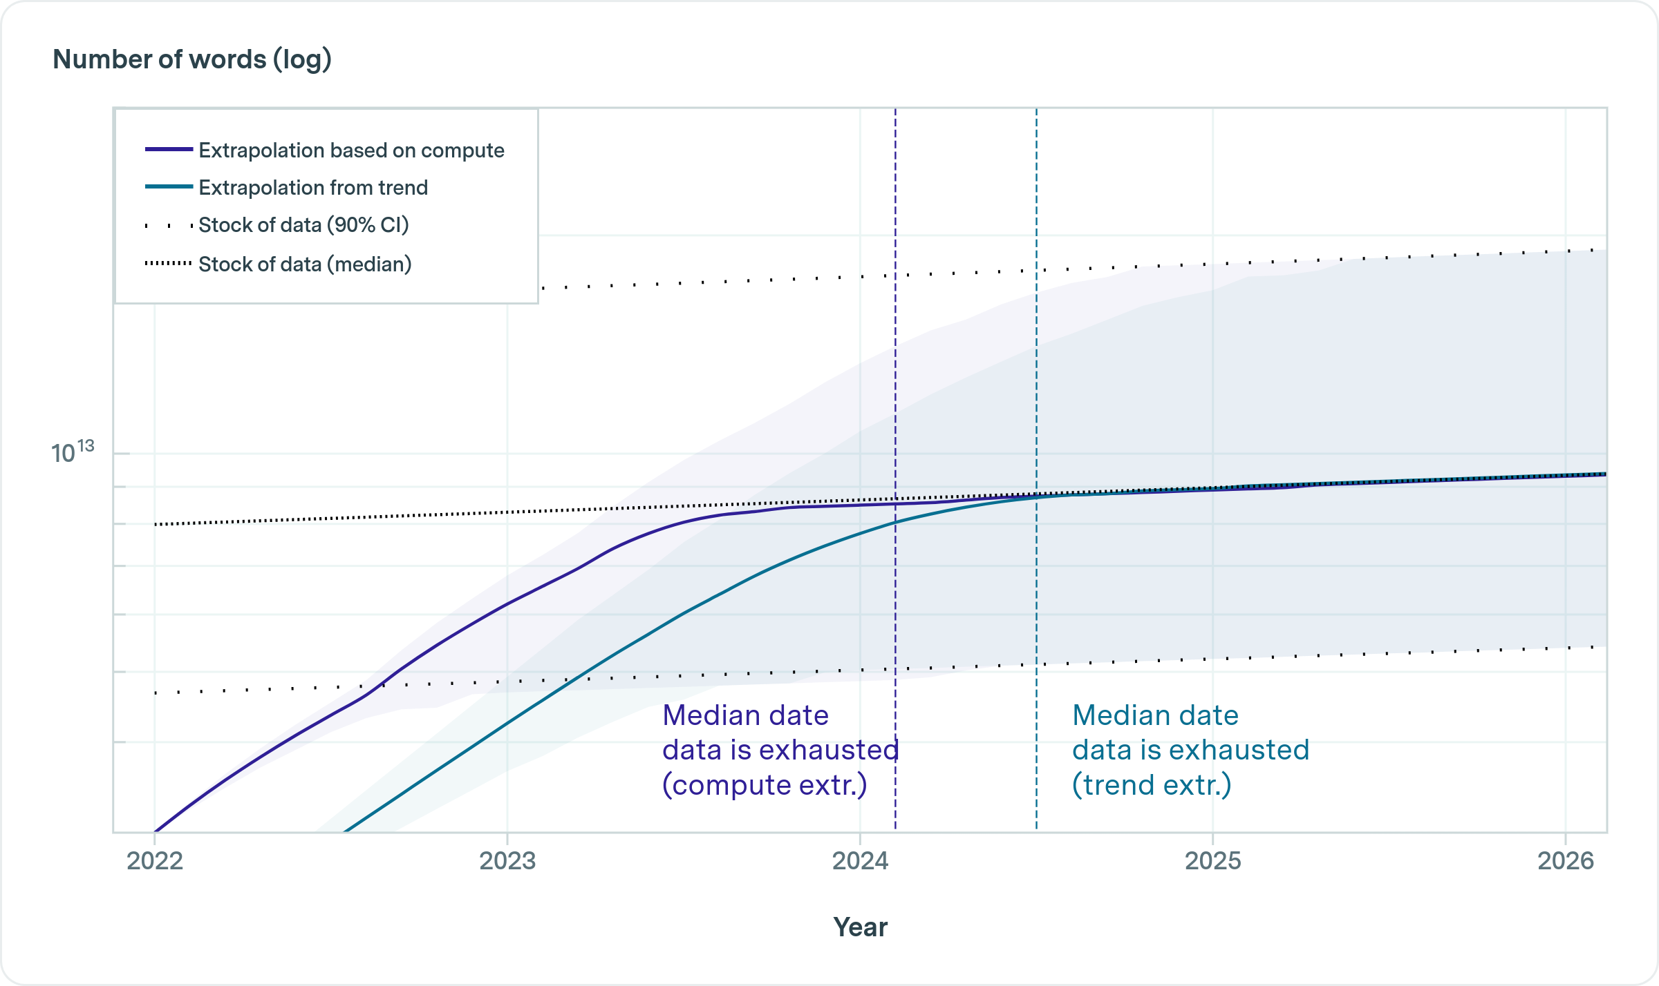
Are we running out of data?
https://epochai.org/blog/will-we-run-out-of-ml-data-evidence-from-projecting-dataset
Notes:
Build up slide together

Slide 14
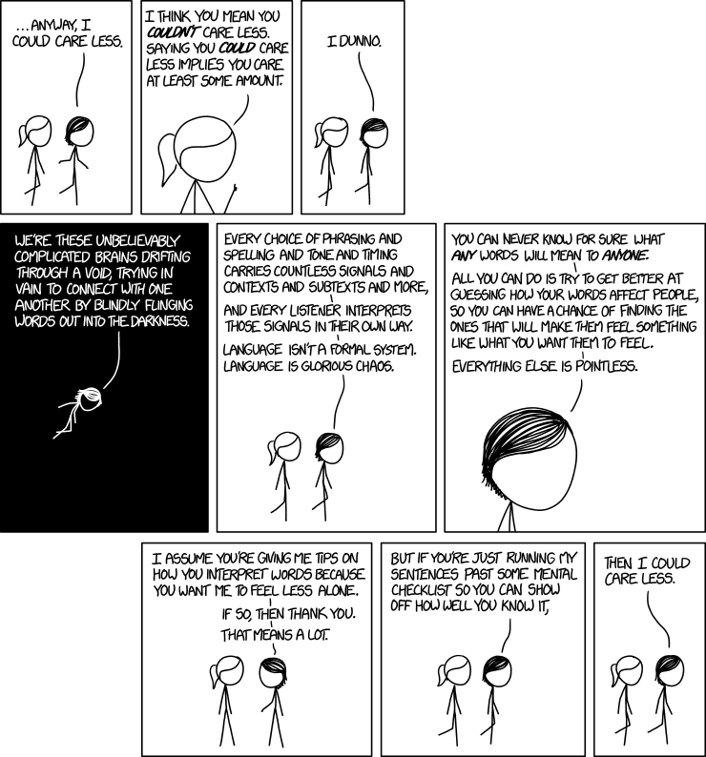
WHAT MAKES LANGUAGE HARD?
Source
XKCD
Notes:
Jos

Slide 15
“Lost ring was found by tree”
Near the vicinity of a tree, a stolen piece of jewelry was found.
Correct interpretation almost always.
A walking tree was searching for a stolen piece of jewelry and found it.
Correct interpretation in Lord of the Rings.
Notes:
Jos

Slide 16


DEFINE:
NATURAL LANGUAGE PROCESSING
😴“Natural language processing (NLP) is a subfield of linguistics, computer science, and artificial intelligence concerned with the interactions between computers and human language, in particular how to program computers to process and analyze large amounts of natural language data.”
- Wikipedia
👍“Getting computers to do useful things with free-form text.”
- Nitin Punjabi, NLP demystified

Slide 17
Some NLP tasks and applications
Applications
Chatbots
E-mail classification
Spam filters
Hate speech detection
Auto-correct
Smart assistants
Summarisation
Google and other semantic search
Knowledge base mining
Contract analysis
…
Tasks
Classification
Named entity recognition
Coreference resolution
Sentiment analysis
Text generation
Fill the gap
Question answering
Entity linking
Knowledge base retrieval
…
744 tasks defined on PapersWithCode
Notes:
Sentiment analysis IS classification of course.

Slide 18
Some definitions to get started
Example / document
One instance
Tokens
fundamental modelling unit: can be word, number, subword, a couple of words, punctuation
Sentence
Corpus
a collection of examples
Morpheme
smallest piece of a word in speech that contains meaning (-ing, pre-, un-, oo)
Grapheme
smallest piece of a word in text = Characters in English
Embedding
Numerical vector (so 1-dimensional). Typically the output of a function that has a [token/sentence/document/…] as input
Notes:
Jos

Slide 19
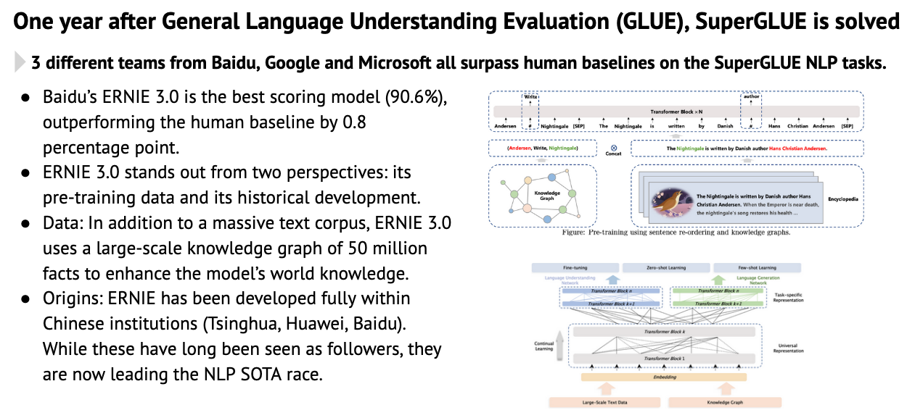
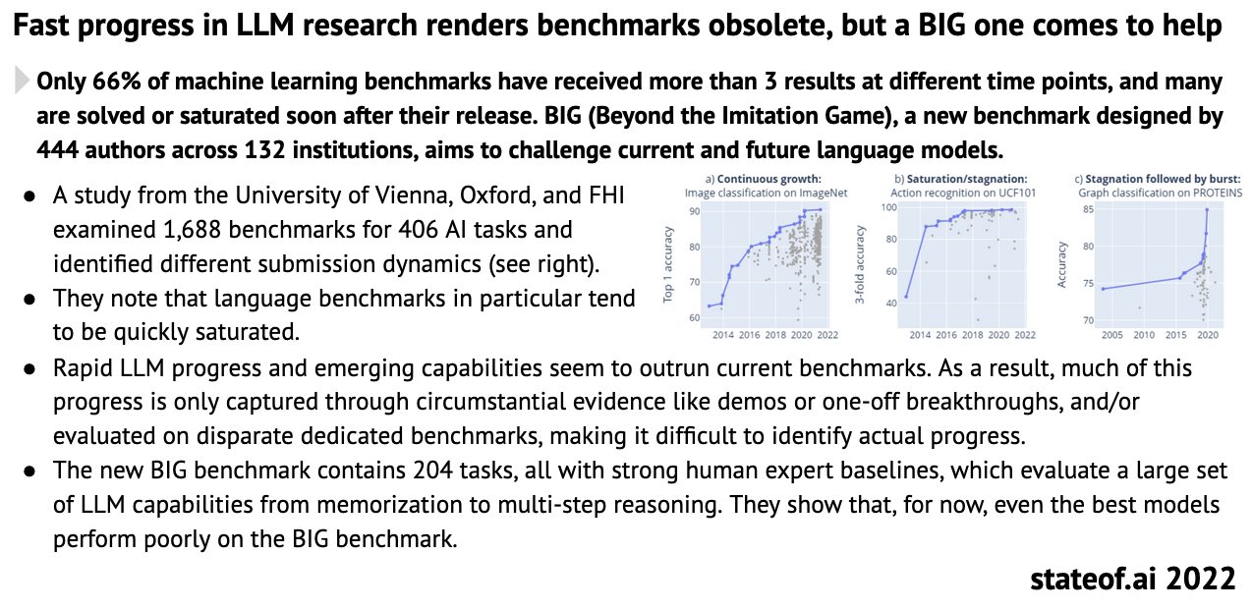
Natural Language Processing
One of the hottest fields in the world with new breakthroughs every couple of months.
This also implies that this course will be outdated quickly!
Source: State of AI 2021 and 2022
Notes:
Jos

Slide 20
PRACTICALS
LET’S GET THE BORING STUFF OUT OF THE WAY!
Notes:
9:25

Slide 21
INTRODUCTION
THIS COURSE
WHAT
Identify business opportunities for using Natural Language Processing
Create professional project pitches for innovative NLP use cases including feasibility estimate, data requirements, implementation effort and common pitfalls
Learn different methods of transforming unstructured data into structured data
Build and evaluate your own NLP models using state-of-the-art NLP tools
HOW
By discussing real-life business examples from the field
Hands-on implementation of 3 cases. Data and boilerplate code will be provided.
A chat bot
Assignment based on a fixed data set
Open-ended NLP project
Notes:
Jos

Slide 22
INTRODUCTION
TABLE OF CONTENTS
Date | What
Wed 10/01 - PM | Intro to NLP + Simple models
Thu 11 /01 - AM | Transformers + Word embeddings
Fri 12 / 01 - PM | Transfer learning Guest lecture: Joachim Jonckers (Sinch)
Fri 16 / 01 - PM | Search and Retrieval
Tue 19/01 - AM | LLMs and the future
https://learning.vlerick.com/courses/3773/modules
Notes:
Jos

Slide 23
WHAT IS NOT COVERED IN THIS COURSE
Mathematical rigor
Full implementations
Linguistics
Programming
Reading and understanding NLP papers
Research ideas and directions
Notes:
Jos

Slide 24
GRADING & EVALUATION
https://learning.vlerick.com/courses/3773/assignments
Notes:
Jos

Slide 25
WHO AM I?
“Mathematician”
Helped with starting three successful A.I. startups: Metamaze, Chatlayer and Faktion.
Done 80+ NLP projects all over the world
Likes books, running, climbing (rock, alpine, indoor), vegan
I am the original creator of pandas -profiling
My mission: Apply AI in a way that contributes to society
🏆
Deloitte Rising Star 2023 – top 10
Datanews Tech Start-up of the year 2022
InQbet hackathon 1st place for AI lab assistant
Data Impact Challenge: Predicting suicide risk from social media behavior
Data Summit AI Scale-up of the year 2019
Notes:
Jos

Slide 26
FROM VERBS TO VECTORS FROM WORDS TO WEIGHTS
THE FUNDAMENTAL DIFFICULTY IN NLP
Notes:
9:30

Slide 27
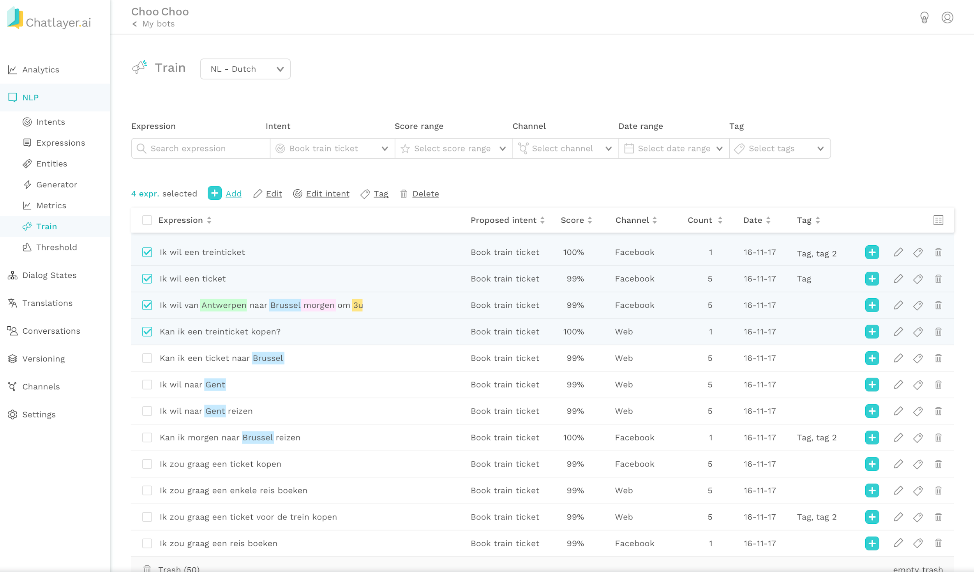
ONCE WE HAVE NUMBERS…
Topic detection is just clustering
Intent recognition is just classification
Spell correcting is just anomaly detection
Sentiment analysis is just regression
Entity extraction is just series classification
... and so on

Slide 28

ML Engineers transform problems into math
Input
Model
Output
Deep Learning
Numbers
Numbers
Optimization
Categories
Classification, probability
Categories
Regression, prediction
Images
Images
Clustering, segmentation
SCOPE OF THIS COURSE!
Text
Anomaly detection
Text
Forecasting
Audio/voice
Audio/voice
Graph analysis
Notes:
Use some fancy modelling words.
This might sound simplistic, but it is not. It’s a structured way of thinking about these problems and distilling the essence.

Slide 29
Stop words
Stop words are words that don’t add value.
Stop word lists are built-in in Spacy and can be found online
Sidenote: e.g. for sentiment analyses, do NOT remove “NOT”.
I did not like this movie != I did like this movie
Notes:
Jos

Slide 30
PREPROCESSING PIPELINE
Ignore casing
Standardize characters
Tokenize
Remove stop words
Lemmatise
Embed
Model
Important: apply exactly the same pipeline to the training corpus as when predicting new examples
Notes:
9:45 - 10:15

Slide 31

Let’s preprocess some data

Slide 32
Simple embedding
Bag-of-words
 | Doc A | Doc B
alice | 1 | 1
also | 0 | 1
bob | 1 | 0
harry | 0 | 1
likes | 2 | 1
movies | 2 | 0
potter | 0 | 1
to | 1 | 1
too | 1 | 0
watch | 1 | 1
Document A:
Alice likes to watch movies. Bob likes movies too.
Document B:
Alice also likes to watch Harry Potter
https://spacy.io/api/architectures/#TextCatBOW
Notes:
Jos

Slide 33
Let’s build a simple BOW model

Slide 34
How to ML / NLP
An opinionated way on what to do
Always start by immersing yourself in the data
Tokenizer, language, vocabulary, domain, OOV tokens, …
Create a baseline model.
Example: use tf-idf/BOW + random forests.
It is better to start with underfitting than with overfitting.
Set up a complete pipeline
End-to-end training
Evaluation pipeline
Experiment tracking (even if just a handwritten notebook)
Perform basic error analysis and QA.
Fix data errors first
Look at predictions
Look at mispredictions / residuals
Fix any bugs in pipeline
Make model overfit and underfit on purpose
Make sure there is no test set leakage
Experiment.
Use more complex models, guided by error analysis
Use different embeddings or foundation models
Increase or decrease hyperparameters like number of layers, vocab size, … depending on overfit/underfit.
Track your experiments clearly
General tips:
Don’t be afraid of reading documentation
Work from first principles
Have fun

Slide 35
TF-IDF embeddings
TERM FREQUENCY INVERSE DOCUMENT FEQUENCY
For a set of documents D, one document d and a term t
Term Frequency tf
tf(t,d) = count of t in d / number of words in d
“How often this document uses term t”
Inverse document frequency idf
N(t) = Number of documents containing the term t
idf(t, D) = log (N / N (t)) “How much information does this word provide”
Many other variations are possible
Tfidf(t, d, D) = tf(t,d) * idf(t, D)
This works because
If a term is in every document, it will get very low weights
Rare terms are more informative and get a higher weight
If terms occur frequently in one document, the weight is higher
Want to learn more?
https://www.nlpdemystified.org/course/tf-idf
https://en.wikipedia.org/wiki/Tf%E2%80%93idf
Notes:
Jos

Slide 36
Let’s build a simple TF-IDF model

Slide 37
When to use TF-IDF
Business Case
TF IDF is for text classification what logistic regression is for structured classification: it is a safe bet that will easily work and reach some reasonable accuracy
Advantages
Simple
Explainable and understandable
Low computational overhead
Disadvantages
Not multilingual
Doesn’t actually understanding anything
Does not take into account word order
You can beat it – of course – but not easily and likely by sacrificing interpretability.

Slide 38
BUILDING APPLICATIONS
BUILDING APPLICATIONS

Slide 39
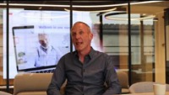
CASE STUDY – EUROP ASSISTANCE

Slide 40
Case study – Mailroom automation
Business case – BUILD vs BUY
Let’s build up business case spreadsheet together!

Slide 41
Applications – Classification in NLP
Spam filtering
Classify legal clauses for standardization
Content moderation: detecting hate speech, racism, sexism, extremism, bullying, bot detection
Sentiment analysis
Predicting stock market or crypto market based on tweets (data)
Newspaper tagging
Intent recognition in chatbots
Fake news detection
Text Author Profiling (gender, age, personality, …)
Support ticket routing
Predicting ad success
Business case depends on:
Volume of recurring classes
Current manual effort for existing cases, added value for new cases
Feasibility
Feasibility depends on:
Limited number of classes
Not too much ”world knowledge” needed or subtle differences in wordings
Data availability: there is annotated data or an easy way to self-supervise or weakly supervise
Easy for humans = easy for AI
Watch out for:
Negations
Multi-label problems

Slide 42
Limitations
Why we’ll need TRANSFORMERS

Slide 43
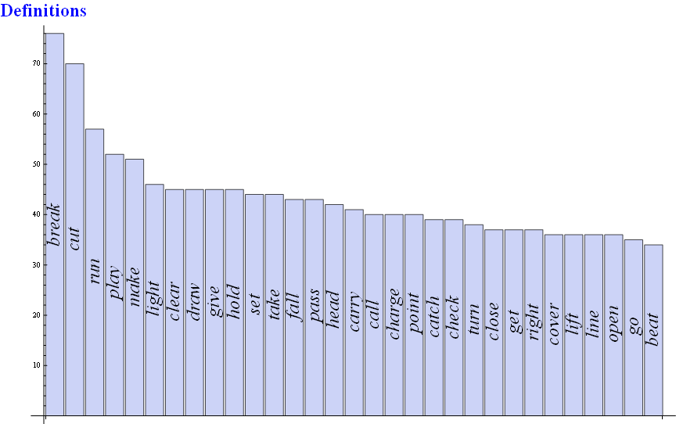
PROBLEM
The same word means different things depending on context

Slide 44
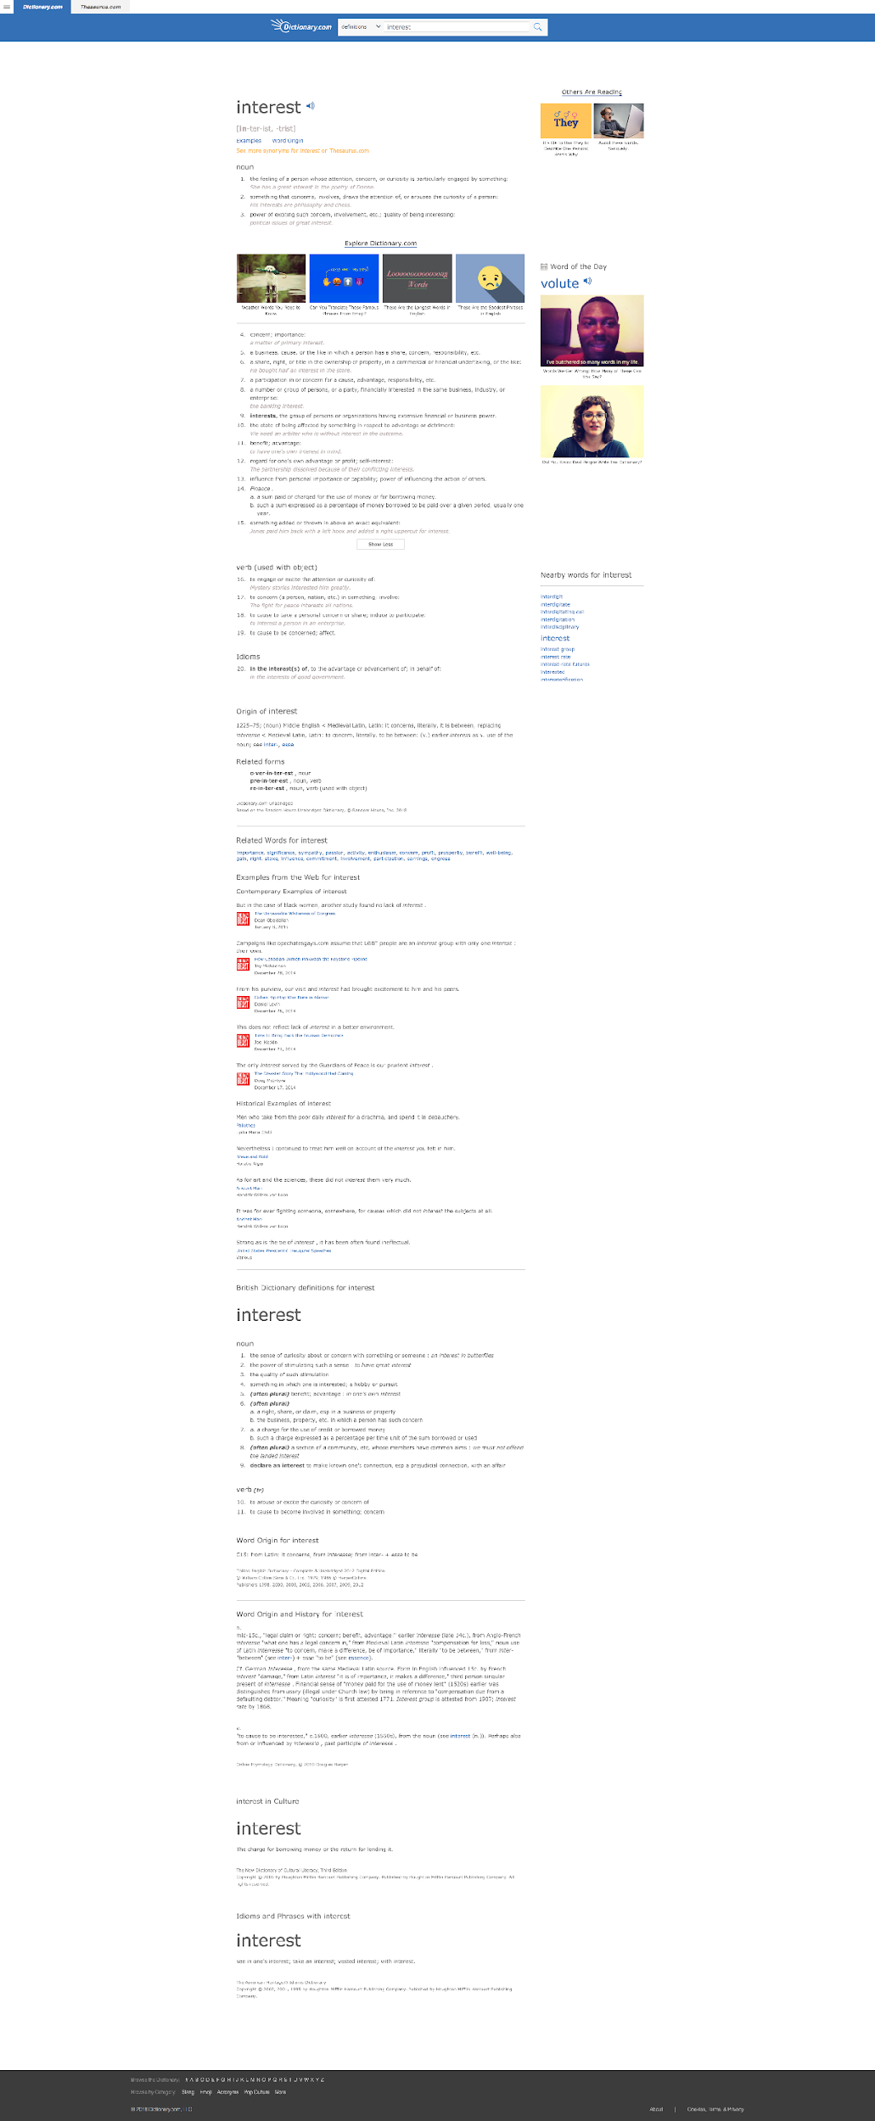
Interest
Solution 1
Force domain specific knowledge by fine-tuning embeddings

Slide 45
Interest
Solution 2
Use Language Models instead of embeddings

Slide 46
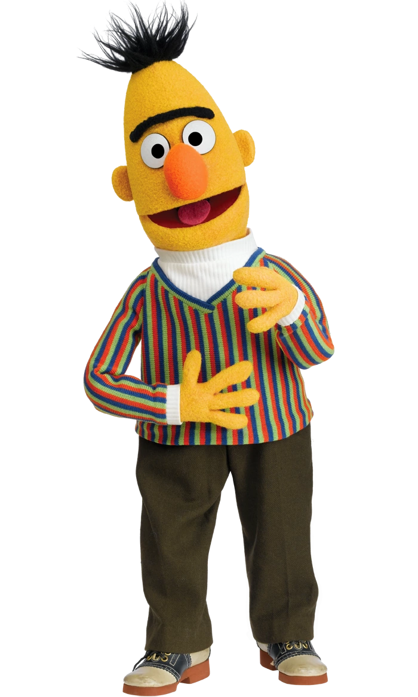

ELMo (Mar 2018)
Embeddings for Language Models
BERT (Oct 2018)
Bidirectional Encoder Representations from Transformers
Notes:
ELMO: Allen.ai
BERT: Google

Slide 47
Interest
Solution 3: combine
Fine-tune language models based on domain data
Notes:
https://metamazeeu-my.sharepoint.com/:x:/g/personal/j_polfliet_metamaze_eu/EV5gk_JvEAZFkVehGL__Pv0BdrwGs87rNhl90iLgl3S_dw?e=BKdcuf

Slide 48
Mandatory Preparation for next lesson
Required
Financial times’ intro to Generative AI https://ig.ft.com/generative-ai/
Attention: https://jalammar.github.io/visualizing-neural-machine-translation-mechanics-of-seq2seq-models-with-attention/
Transformers - theory https://jalammar.github.io/illustrated-transformer/
Optional: actual code implementations
https://nn.labml.ai/transformers/mha.html
https://nn.labml.ai/transformers/positional_encoding.html
https://nn.labml.ai/transformers/models.html#section-7
https://jaykmody.com/blog/gpt-from-scratch/
Math details: https://osanseviero.github.io/hackerllama/blog/posts/random_transformer/

Slide 49
Lecture 2
MAI NLP

Slide 50
Transformers
Guess how hard they are.
https://informationisbeautiful.net/visualizations/million-lines-of-code/

Slide 51
Let’s build a GPT

Slide 52
FROM VERBS TO VECTORS FROM WORDS TO WEIGHTS
THE FUNDAMENTAL DIFFICULTY IN NLP
Part 2

Slide 53
Modelling text with Transformers
300 ‘meaning’ dimensions
word | Male/female | name | regalness | …
King | 0 | 0 | 1 | …
Queen | 1 | 0 | 1 | …
Porsche | 0.3 | 0.2 | 0.3 | …
Fiat 500 | 0.6 | 0 | 0 | …
Lieselotte | 1 | 1 | 0.1 | …
Elizabeth | 1 | 1 | 0.4 | …
… | … | … | … | …
Word embeddings
Numerical vectors that describe the meaning of the word. Created by large text corpora and huge amounts of processing power. These make the computations feasible. Word embeddings can be reused in multiple use cases.
1.6 million words
Disclaimer: this is an example to build intuition. In reality, these dimensions are abstract and their meaning unclear
Notes:
Disclaimer: this is an example to build intuition. In reality, these dimensions are abstract and their meaning unclear

Slide 54
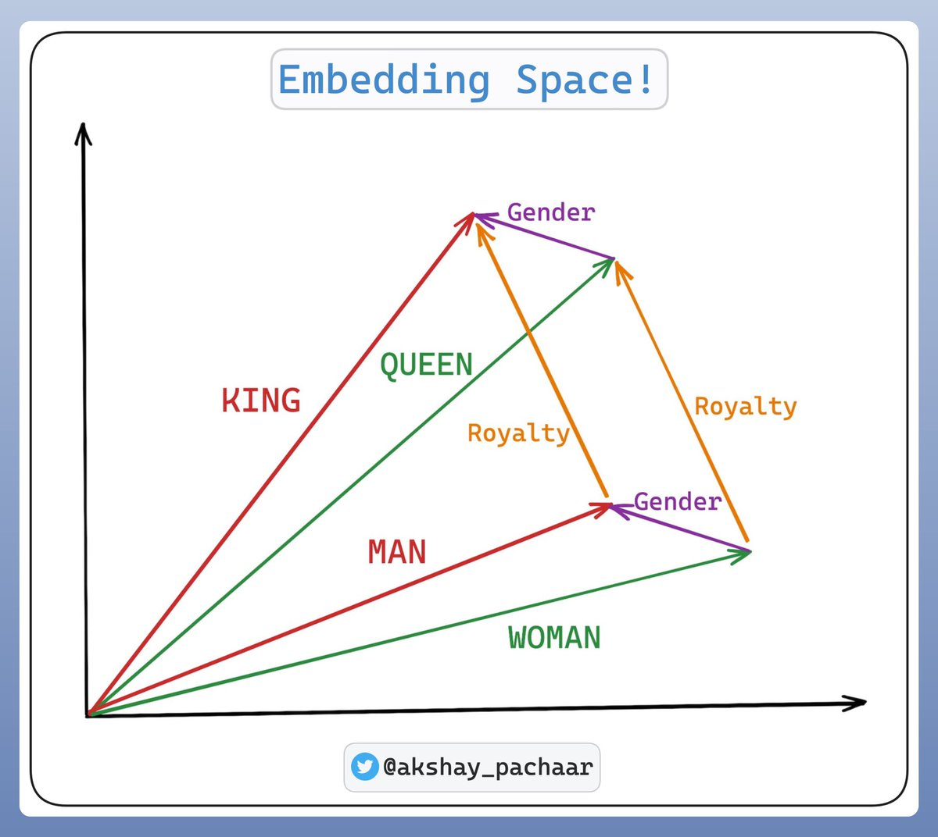
https://twitter.com/akshay_pachaar/status/1682729799926816768

Slide 55
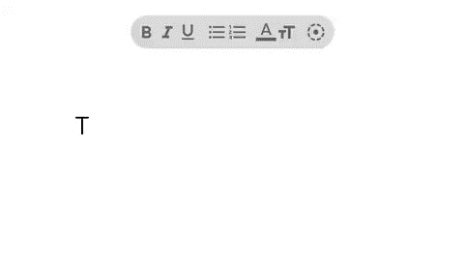
Word arithmetic can be very powerful
Source: https://twitter.com/MatthewWSiu/status/1560725842019368962?s=20&t=aU1XyED9fz5_IO9aXJM8VQ

Slide 56
Hands-on word arithmetic
Try out different prompts
Can you find bias? E.g. man is to doctor as women is to […]
Can you find synonyms?
Can you find antonyms?
Can you find clusters of words?
Feeling adventurous? Build the application from the last slide!
Post interesting observations real-time on Slack using this link

Slide 57
Explorer
https://bbycroft.net/llm

Slide 58
APPLICATIONS
EMBEDDINGS

Slide 59
Using Embeddings - Examples
Example: Named Entity Recognition for extracting information from e-mails
Word-level classifier in RNN
Example: Sentiment analysis
Document embeddings + simple classifier
Example: Author clustering of r/wallstreetbets
- …
Example: Fake news detection https://www.kaggle.com/datasets/clmentbisaillon/fake-and-real-news-dataset
…
Example: Knowledge base creation
Notes:
Change code together.

Slide 60
Applications of Embeddings
“Word2vec” was the most cited paper in NLP before “Attention is all you need”
Spell checking: It’s just the cloze task!
Synonyms: It’s just clustering on word level!
Topic modelling / clustering: It’s just …
Semantic search: It’s just …
Document similarity: It’s just …
Gmail’s sentence completion: It’s just …
CV matching: It’s just …
Grammarly: It’s just …
Chatbot intent recognition: It’s just …
Named entity recognition: It’s just …
Most importantly: embeddings are the foundation of all modern NLP.
Notes:
Short recap of lesson 1 + extra examples

Slide 61
TRANSFER LEARNING

Slide 62
LEVELS OF PRETRAINING
Main question: how can I use data from different datasets in a small way so that I don’t need to collect a lot of task-specific data?
Train from scratch
Feature-based: Train new model on embeddings
Finetuning I: Freeze all but output layer weights
Finetuning II: Update all weights
Zero-shot learning
Few-shot learning
RAG
Notes:
Jos

Slide 63
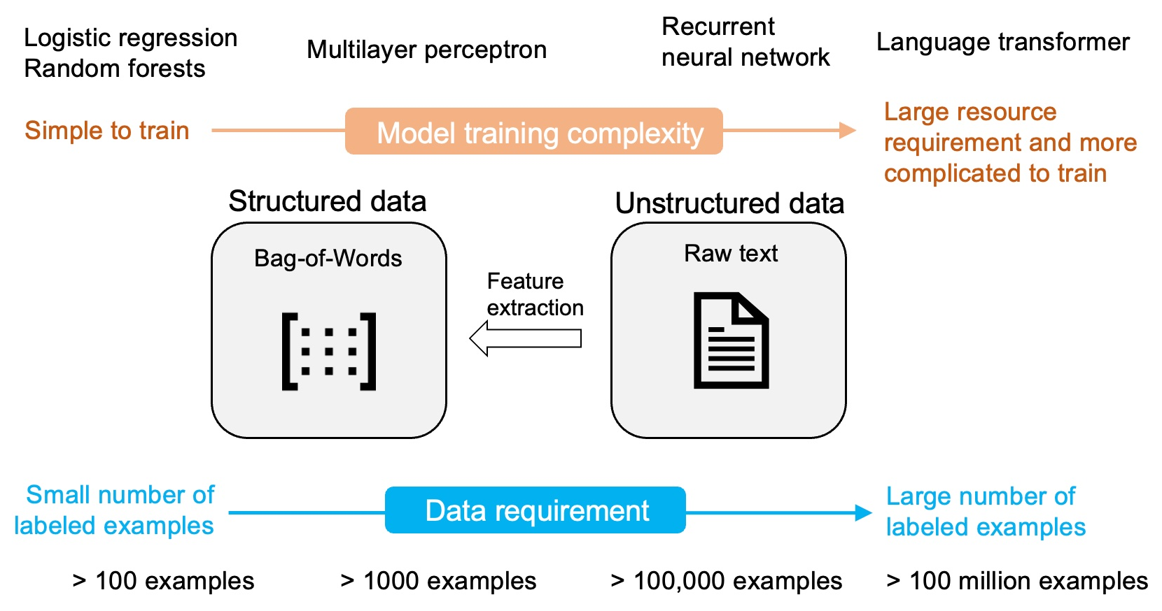
1. TRAIN FROM SCRATCH
Expensive!
Source: Sebastian Raschka

Slide 64
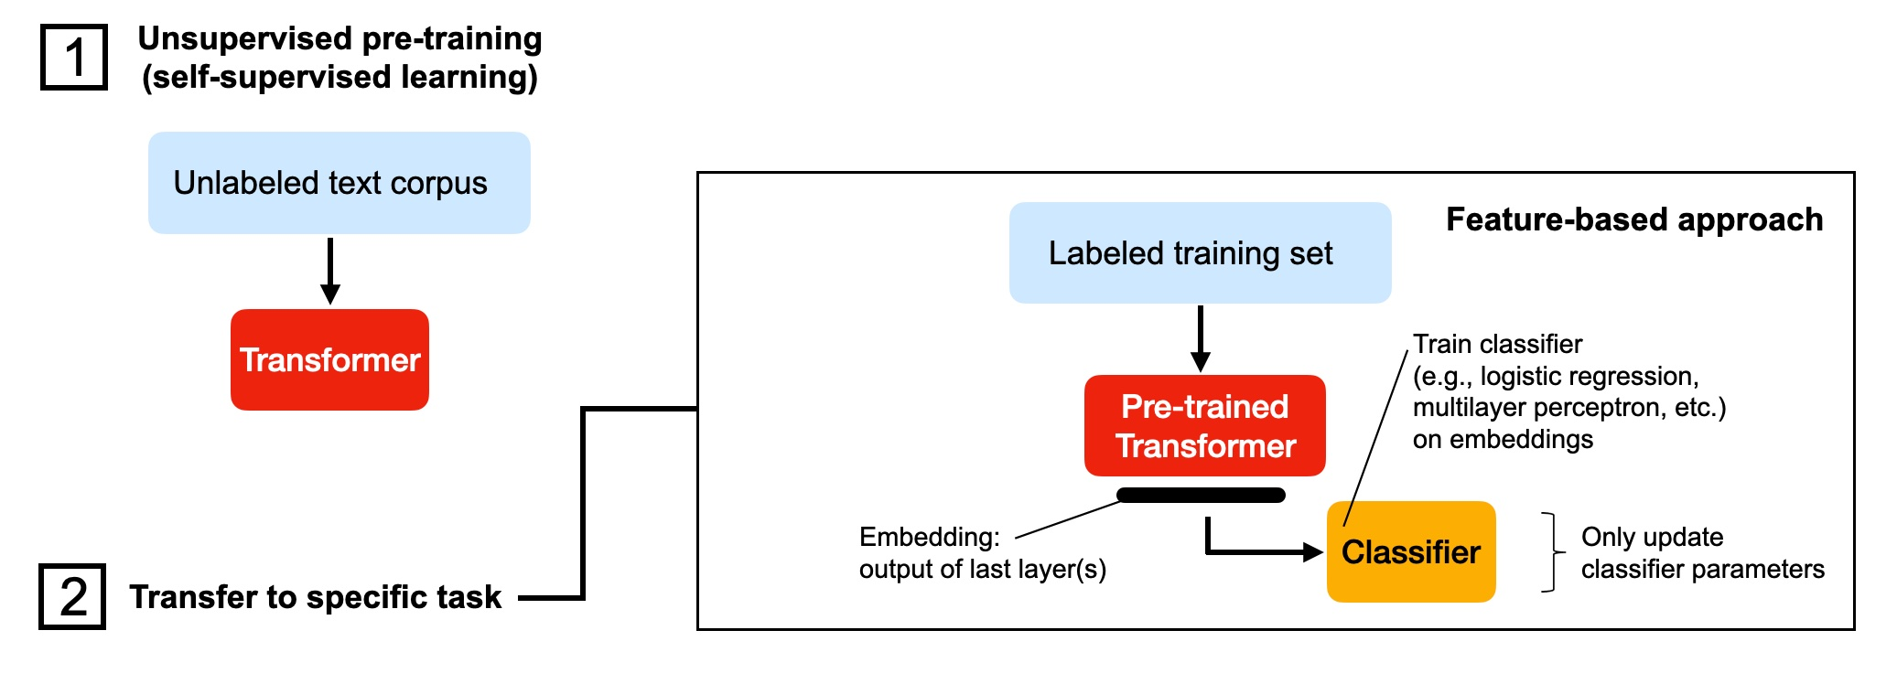
2. FEATURE-BASED: Train new models on fixed embeddings
Almost exactly the same as we did with simple embeddings!
Source: Sebastian Raschka

Slide 65
Let’s train based on fixed embeddings

Slide 66
Using Embeddings
Decide on the proper modelling level: word, sentence, paragraph, document, … This will become one “example”
Decide how to summarize embeddings into that example (if needed): averaging, sentence encoding, concatenating, …
Use the ML models you already know (Random Forests, Support Vector Machines, CNN’s, Bi-LSTM, …)
Notes:
Jos

Slide 67
DATA-CENTRIC ML
The data is never what you expect it to be
Find outliers by analyzing misprediction residuals and using cross validation
Use different sentiment classifier and compare predictions to find misannotate data
Find clusters in the data
Learn more
Tutorials on bad label detection Calmcode.io
GitHub project cleanlab
Examples in popular datasets https://labelerrors.com/
Notes:
Jos

Slide 68
ASSIGNMENT 1
Supervised NLP model

Slide 69
Lecture 3
MAI NLP

Slide 70
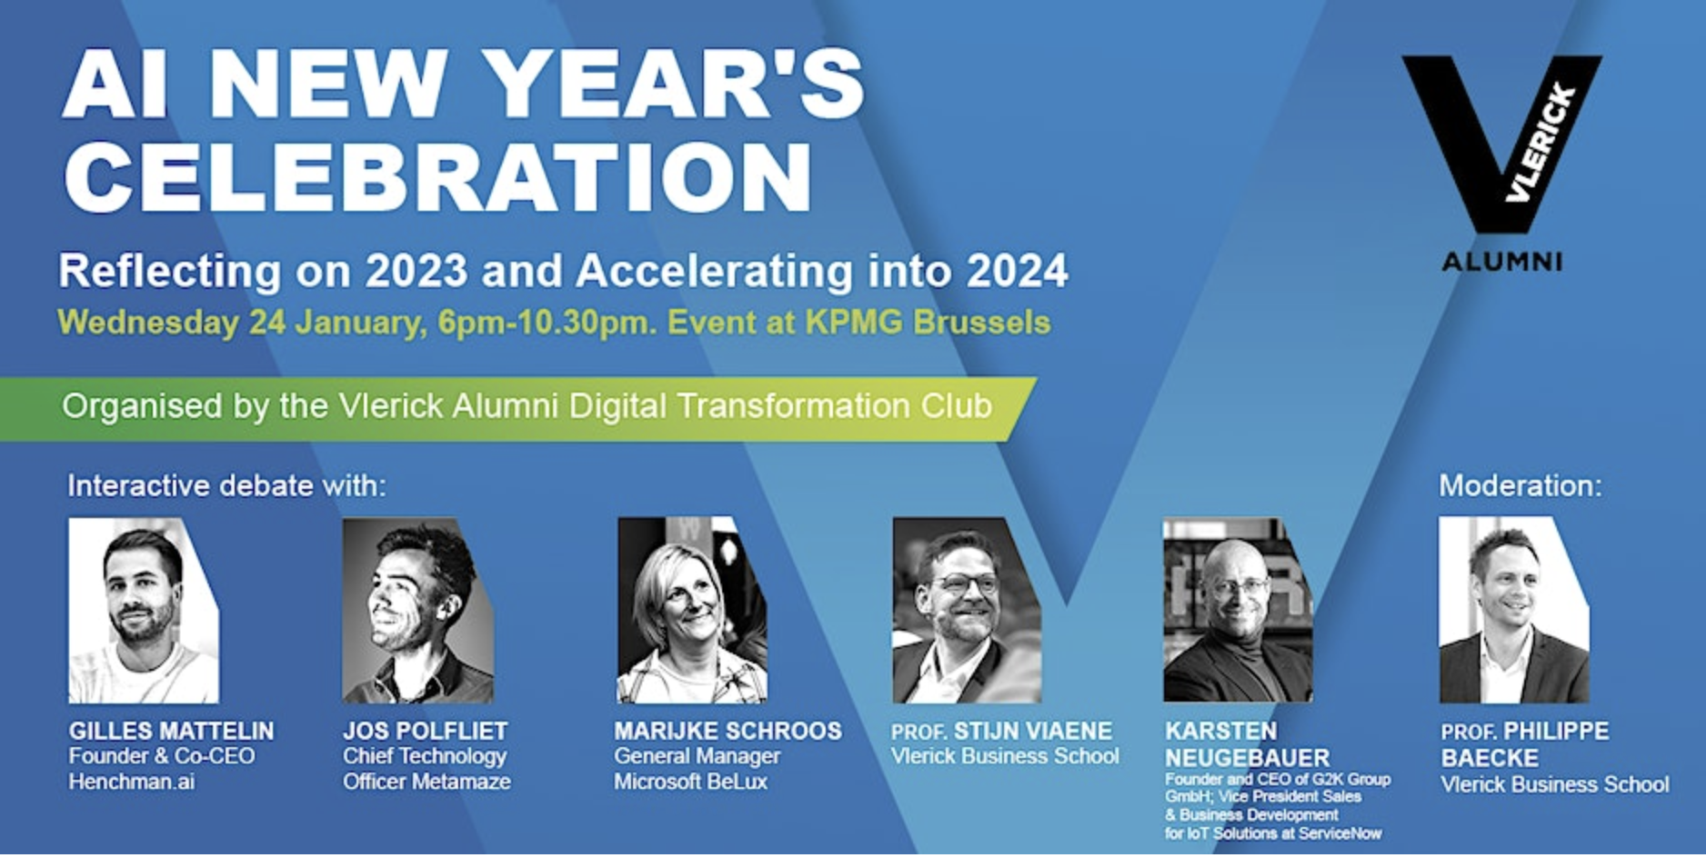
https://www.eventbrite.be/e/vlerick-alumni-digital-transformation-club-ai-new-years-celebration-registration-777085572867?aff=oddtdtcreator

Slide 71
Upgrade 1:
Tokenizer

Slide 72
Byte-pair tokenisation Strong wind was blowing against the static building
1. s/t/r/o/n/g/ /w/i/n/d/ /w/a/s/ /b/l/o/w/i/n/g/ /a/g/a/i/n/s/t/ /t/h/e/ /s/t/a/t/i/c/ /b/u/i/l/d/i/n/g/<eos>
a,b,c,….,z,_,<eos>
Count all character combinations: st : 3 , tr : 1 , ro : 1 , on : 1 , ng : 3 , g : 2 , w : 2 , wi : 2 , in : 4 , nd : 1 ,
Take most frequent one, for example “ng”
2. s/t/r/o/ng/ /w/i/n/d/ /w/a/s/ /b/l/o/w/i/ng/ /a/g/a/i/n/s/t/ /t/h/e/ /s/t/a/t/i/c/ /b/u/i/l/d/i/ng/<eos>
a,b,c,….,z,_,<eos>, ng
3. st/r/o/ng/ /w/i/n/d/ /w/a/s/ /b/l/o/w/i/ng/ /a/g/a/i/n/st/ /t/h/e/ /st/a/t/i/c/ /b/u/i/l/d/i/ng/<eos>
a,b,c,….,z,_,<eos>, ng, st,
4. st/r/o/ng/ /w/i/n/d/ /w/a/s/ /b/l/o/w/ing /a/g/a/i/n/st/ /t/h/e/ /st/a/t/i/c/ /b/u/i/l/d/ing /<eos>
a,b,c,….,z,_,<eos>, ng, st,[ing_],
… continue until you have 50.000 “tokens”.
Notes:
Strong, steady, static, stable, sturdy, stiff, even the Dutch “stevig”, “star”, with morpheme ‘st’ which is a constituent of a word.

Slide 73
Detour: Morphemes
strong | knit
steady | knotted
static | knitting
stable | knobbly
sturdy | knurl
stiff | knuckle
 | knack
rebuild | unfair
recall | unknown
reconnected | unseen
recreate | unusual
reevaluate | unkind
reinforce | unjust
revise | unwilling
kindness | happily
brightness | slowly
sickness | brightly
fitness | boldly
sadness | eagerly
awareness | quietly
sharpness | firmly
Providers of meaning
(defining)
Modifiers of meaning
(semantic)
Modifiers of grammar
(grammatical)
stevig
star
stabilité
Also multilingual!

Slide 74

Byte-pair Tokenisation: Other Examples
Original
Strong wind was blowing against the static building
Less frequent words
Strong wind was blowing against the static brownstone
Typo’s
Strong wind was lbowing against the static building
Unknown words like uncommon names
Jo Vanpaeschen is one of the founders of B-robots
Different languages
Greg – een echte doorzetter – was de CEO aan het stalken
Different scripts
Greg 正在跟踪 CEO

Slide 75
Upgrade 2:
Training Task

Slide 76
My favorite fruit is bananas, because they are so easy to take with you.
apples
oranges
watermelons
sweet
cathedral
litigation
The distribution hypothesis
Words that occur in the same contexts tend to have similar meanings.

Slide 77
Next-word prediction
Strong wind was blowing against the static building. My ears […]
INPUT | OUTPUT
Strong <?> | wind
Strong wind <?> | was
Strong wind was <?> | blowing
Strong wind was blowing <?> | against
Strong wind was blowing against <?> | the
Strong wind was blowing against the <?> | static
Strong wind was blowing against the static <?> | building
Strong wind was blowing against the static building <?> | .
Strong wind was blowing against the static building. <?> | My
Automatically generated training examples, all the model learns is a next word prediction model.

Slide 78
Next-word-prediction is extreme multi-task learning
Task | Example
Grammar | In my free time, I like to {run, banana}
Lexical semantics | I went to the zoo to see giraffes, lions, and {zebras, spoon}
World knowledge | The capital of Denmark is {Copenhagen, London}
Sentiment analysis | Movie review: I was engaged and on the edge of my seat the whole time. The movie was {good, bad}
Harder sentiment analysis | Movie review: Overall, the value I got from the two hours watching it was the sum total of the popcorn and the drink. The movie was {bad, good}
Translation | The word for “pretty” in Spanish is {bonita, hola}
Spatial reasoning | [...] Iroh went into the kitchen to make some tea. Standing next to Iroh, Zuko pondered his destiny. Zuko left the {kitchen, store}
Math question | First grade arithmetic exam: 3 + 8 + 4 = {15, 11}
Grammar | In my free time, I like to {run, banana}
Chess engine | During a critical moment in the game, white made a surprising move: e4 e5 Nf3 Nc6 Bb5 a6 Ba4 Nf6 O-O Be7 Re1 b Bb3 d6 c3 O-O h3 {Nh5, Nb8}"
Automatically generated training examples, all the model learns is a next word prediction model.
Credit Jason Wei – https://docs.google.com/presentation/d/1hQUd3pF8_2Gr2Obc89LKjmHL0DlH-uof9M0yFVd3FA4/edit#slide=id.g28e2e9aa709_0_1
Read more: “Text is the universal interface” https://scale.com/blog/text-universal-interface

Slide 79
Adolphe Quetelet was born in
Paris
Germany
Ghent
Shenzen
Jupyter
Trappist-1a
The danger:
Facts are not probabilistic!

Slide 80
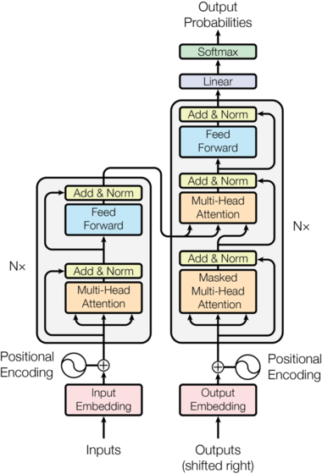
BERT
TOKENIZER: BPE
BERT uses a Byte-pair encoding tokenizer. They are trained on the character level so can deal with misspellings, typo’s and learn grammar, conjugations and lemmatization
PRETRAINING TASK: MASKING
80% of the time: Replace the word with the [MASK] token, e.g., my dog is hairy → my dog is [MASK]
10% of the time: Replace the word with a random word, e.g., my dog is hairy → my dog is apple
10% of the time: Keep the word unchanged, e.g., my dog is hairy → my dog is hairy
PRETRAINING TASK: NEXT SENTENCE PREDICTION
This task makes sure the model learns the context of a sentence. It works by iteratively taking the true next sentence 50% of the time, while taking a random next sentence (considered false) the other 50% of the time.
BERT main innovation: providing a efficient and scalable way to actually train Transformers, proving their worth.
Source “Attention is all you need” paper by Vaswani, et al., 2017
Notes:
Transformer architecture that adds attention mechanisms
BERT is a bit like AlexNet: Convolutional Neural Networks (Transformers) had existed for a long time but didn’t yet blow everything away, until a training regime and architecture was used to completely outperform existing benchmarks by a wide margin. AlexNet kicked off the “Deep Learning” revolution, BERT kicked off the Transformer revolution.

Slide 81
Self supervision!
Collecting supervised training data is very expensive, so one of the most important properties of training Transformer models is the self-supervision.
This is a very powerful paradigm: any task you can find a way to self-supervise can immediately drastically improve your results.
Example: “Language Models Can Teach Themselves to Program Better”(Test accuracy 21.5% => 38.2%) https://arxiv.org/abs/2207.14502
Active research with different learning tasks besides
Word level
Autoregressive models (left-to-right)
Cloze task (fill in the blank)
Masked language modelling (BERT) – fixed per token, with replacement
Dynamic masking (RoBERTa) – changes per token
Word permutation + masking (XLNet)
Mask a span of k tokens (BART)
Sentence or chunk level
Next sentence prediction (BERT) – same doc or not
Sentence order prediction A>B or B>A (ALBERT)
Segment-pair prediction (RoBERTa)
Notes:
Jos

Slide 82
TRANSFER LEARNING

Slide 83
LEVELS OF PRETRAINING
Train from scratch
Feature-based: Train new model on embeddings
Finetuning I: Freeze all but output layer weights
Finetuning II: Update all weights
Zero-shot learning
Few-shot learning
RAG
Notes:
Jos

Slide 84
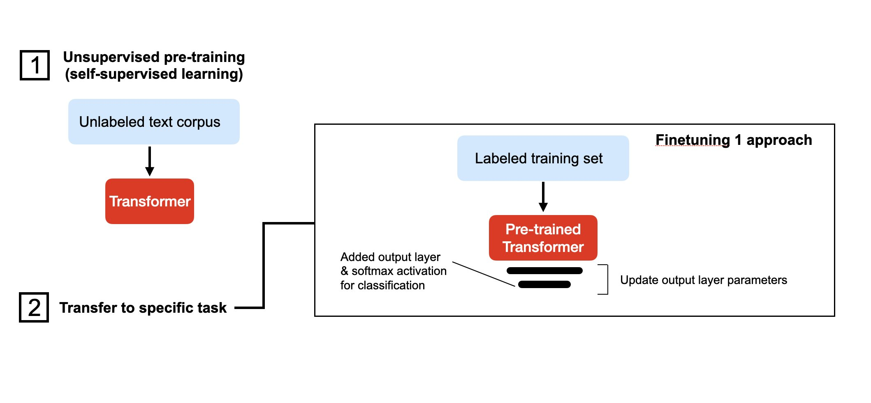
3. FINETUNING I: Freeze all but output layer weights
More accurate and fast. Not super flexible
Source: Sebastian Raschka

Slide 85
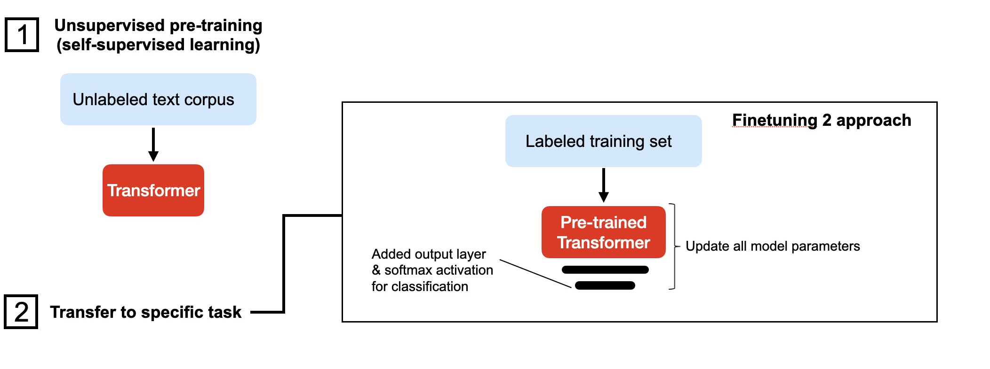
4. FINETUNING II: Update all weights
Most accurate but slower to train, easier to overfit and more expensive.
Source: Sebastian Raschka

Slide 86
Using transformer architectures
Task specific heads
Classification
NER which is token classification
Text generation
Relation extraction
Fill the gap
Question answering
Entity linking
…
See https://huggingface.co/tasks

Slide 87
Let’s fine-tune

Slide 88
Multi-task models
Benefits: More accurate with same amount of data due to shared learning and reduced overfitting
Downsides: Harder to model since you need a bunch of custom code and have good trade-offs between loss functions
Read more in Multi-Task Learning with Deep Neural Networks: A Survey (2020, arXiv)
Notes:
Jos

Slide 89
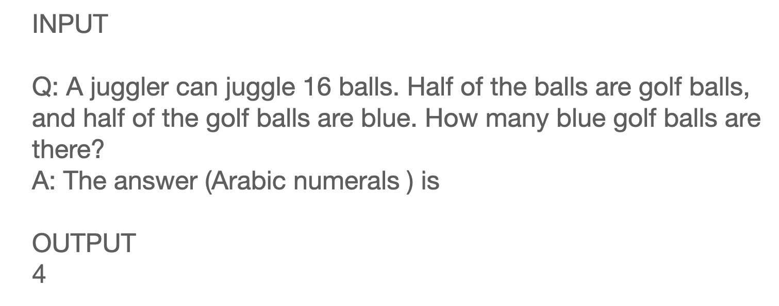
5. Zero shot learning
Good for easy things but still unreliable for harder tasks.
Source: Sebastian Raschka

Slide 90
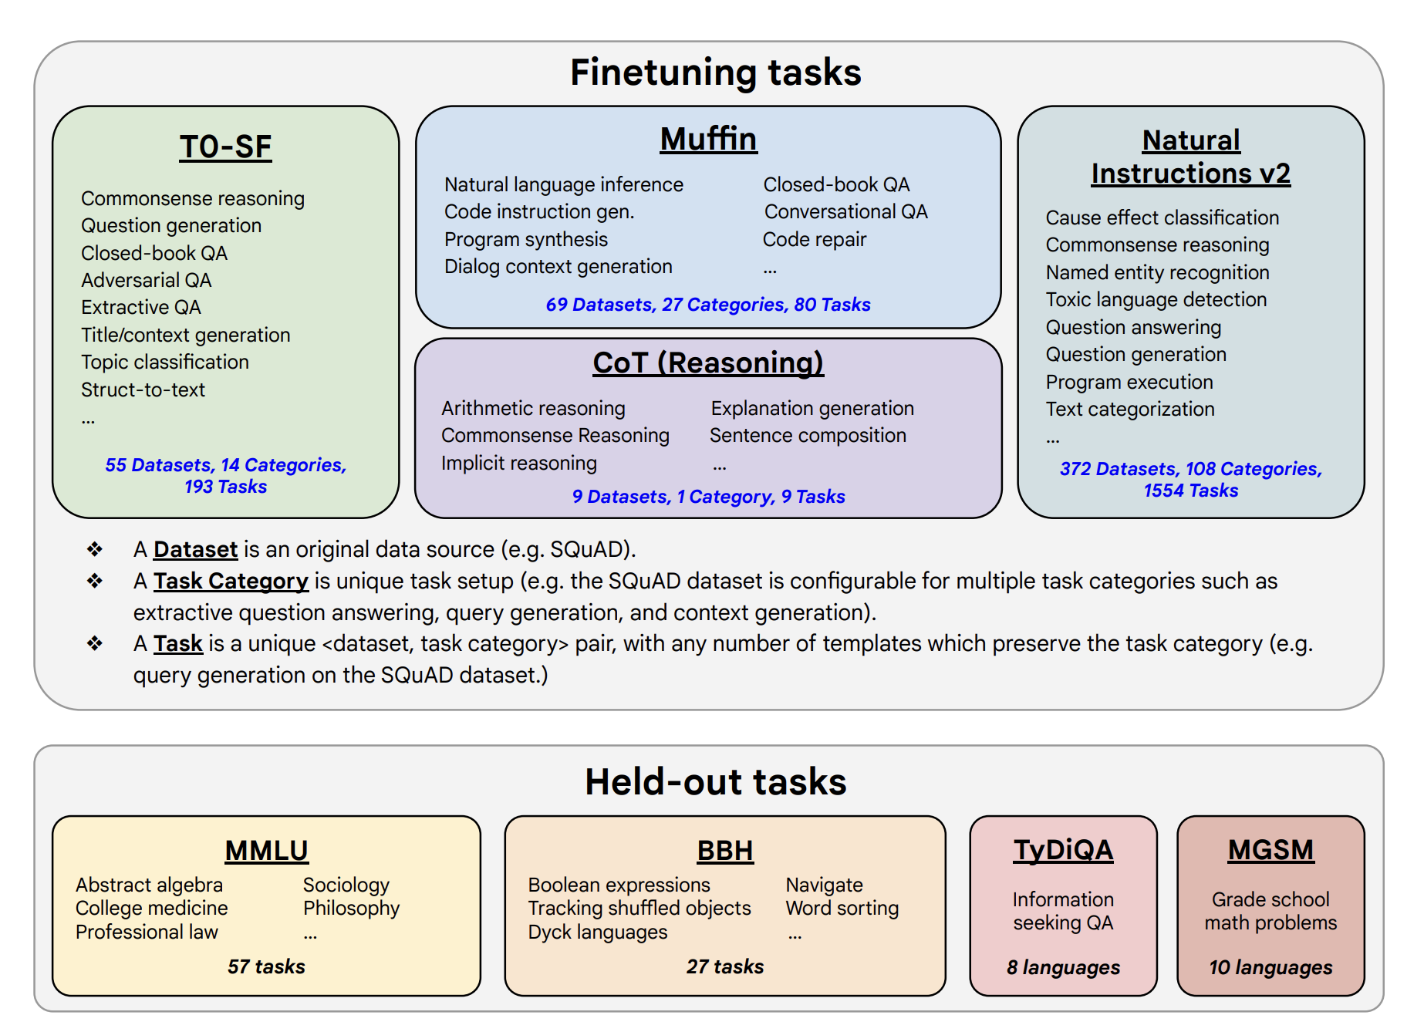
Using transformer architectures
Everything is language, remember 🤷
Basic idea: rephrase what you want to do as a natural language task, and treat every task as natural language generation
This is the basis of “prompting” as a science
T5 model (Google) was the first text-to-text transformer where all tasks are phrased as natural language.
Since then, Flan T5 , a “model that can solve 1800 different tasks” (picture at the right)
This is likely the future for working with LLM’s (next lecture)

Slide 91
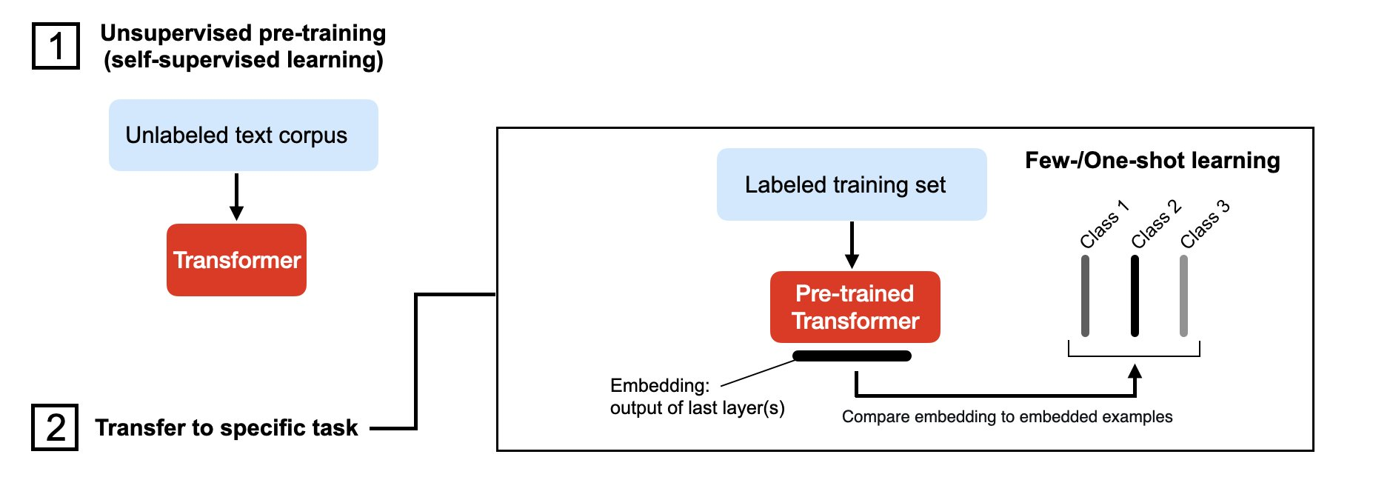
6. Few-shot learning
Cool for demo’s, a bit reliable.
Source: Sebastian Raschka
Notes:
embed examples, then do a nearest neighbor search and select the most similar example.

Slide 92
7. RAG
More next lesson
Source: Sebastian Raschka

Slide 93
LEVELS OF PRETRAINING
Train from scratch
Feature-based: Train new model on embeddings
Finetuning I: Freeze all but output layer weights
Finetuning II: Update all weights
Zero-shot learning
Few-shot learning
RAG
Notes:
Jos

Slide 94
Foundation models
99,9% of compute and data
0,1% Task-specific fine-tuning

Slide 95

Metamaze Hydra architecture – example
Pretraining
>11 million pages
343M parameters
Takes a couple of weeks
Training on your documents
>20 pages
Takes 1-2 hours
Notes:
Raise your hand if you did something professionally this week. Anything, a task,
Now raise your hand if you did something you felt was exactly in the sweet spot of your expertise, the part where you are likely one of the most knowledgeable people in the world.
Pick one of the others

Slide 96
Transfer learning - history
When | Before 2014 | ~2014 | ~2018 | ~2020 | 2022-2023
Name | Linguistics era | Embeddings era | Large Language Models | Generative models | LLM+RLHF
Pretraining | None, you train everything from scratch | Words | Words + Context | Words + Context + Task | LLM Human feedback
Models | Tf-idf, Bag-of-words | Word2vec, glove | BERT, ELMO, Roberta, Bertje | GPT2, Bloom, Neo, … | ChatGPT, GPT4, Falcon, LLama
Examples needed to train base model | 1.000-10.000 | ~50M tokens | 3,3B tokens 340M params | 500B tokens | 2T tokens 70B params
Examples needed for one task | 1.000-10.000 | 100-1.000 | 10-100 | 1-10 | 0
Note: grossly oversimplified !

Slide 97
HOW TO USE
TRANSFORMERS

Slide 98
Training or choosing models
TRANSFER LEARNING
Easy to set-up, needs less data
CamemBert, BertJe, Robbert, Robert, Albert, Bart, Flaubert, Longformer, Reformer, BigBird, … why are there so many and how do I choose?
Take into account:
Language
Domain (newspaper, web, code, …)
Suitable number of parameters
Pre-trained models available
Sequence length
Modality
Model size (cost!)
TRAINING FROM SCRATCH
A lot more work to set-up. More time, more compute, more data is needed.
From scratch or fine-tune are both possible
If you have sufficient data and compute resources, will likely outperform existing embeddings

Slide 99
How to Find Datasets and Architectures
Paperswithcode
Kaggle
Nlpprogress
(super) GLUE
CONNL
Hugging Face Datasets
https://datasetsearch.research.google.com/
https://machinelearningmastery.com/datasets-natural-language-processing/
https://github.com/niderhoff/nlp-datasets

Slide 100
Many more language models exist
They are different in
Self-supervised training task(s)
Hyperparameters like number of heads, layers,
Attention mechanisms
Tokenizers
Batch sizes
https://huggingface.co/transformers/v3.1.0/model_summary.html
Notes:
Jos

Slide 101
Guest Lecture
Joachim Jonckers
Director of Product at Sinch

Slide 102
PRACTICE ASSIGNMENT
Building a chatbot

Slide 103
PRACTICE ASSIGNMENT
Building a chatbot
Groups division on Canvas
Timing
Deadline is 15/01 at 12:00
Deliverables
1 min recorded pitch
Grading
This assignment will not be graded. Use it to get feedback.
Really good submissions or bad submission will count towards “Classroom participation”
We will look into the results in Lecture 4 on 16/01
Focus on
Application: opportunity, feasibility, business case, …
Implementation: technique, results, …
Presentation

Slide 104
Lecture 4
MAI NLP

Slide 105
REVIEW
Practice assignment Chatbots
Notes:
Niels

Slide 106
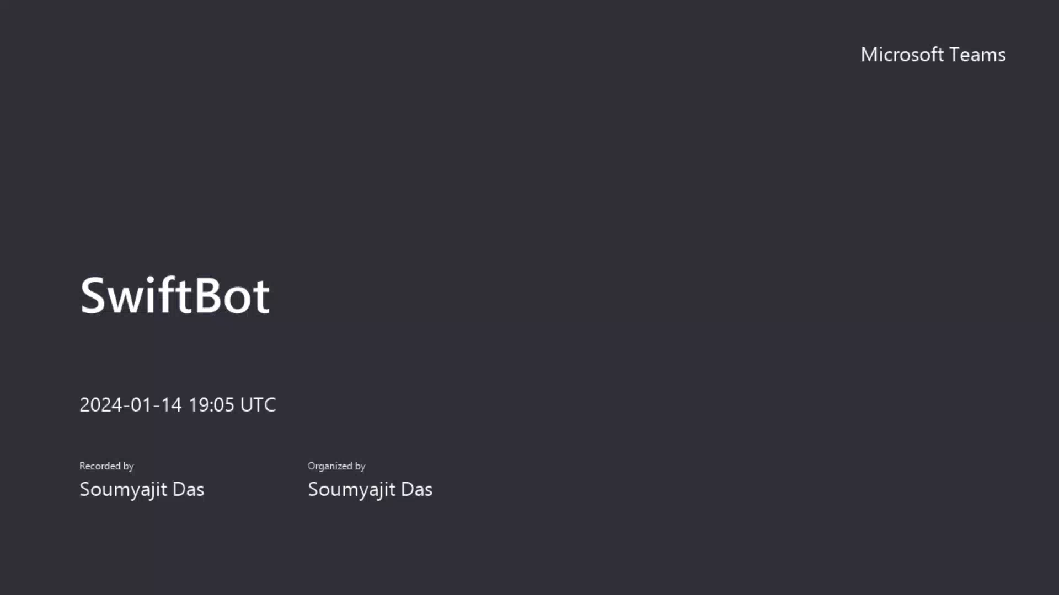

Slide 107
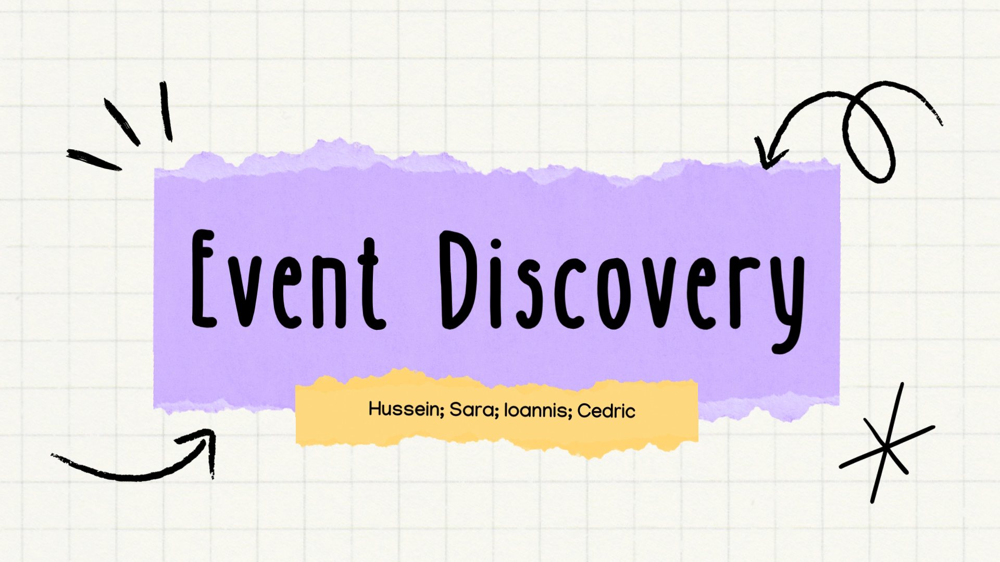

Slide 108


Slide 109
QUESTIONS?
ASSIGNMENT 1, PREVIOUS LECTURES,…?

Slide 110
Sentences and Documents
Combine a sequence of word embeddings into one embedding
Averaging
Min / Max
Transposing
CNN’s
Dimensionality reduction like Principal Component Analysis
Time series analysis techniques
…
Good to get creative!
Notes:
Jos

Slide 111
Let’s build a search engine

Slide 112
Search and information retrieval
Example Use Cases
Search and information retrieval
CV Matching
Legal discovery and search
Website search
Public law enforcement: find similar PV’s
Knowledge base suggestion
Specific applications
Spell checker
Grammar checker
Find emerging technologies
Notes:
Make this

Slide 113
Sentence and document embeddings for retrieval
As always, pay attention to
The task you need (sometimes possible by giving “instructions”)
Language support
Embedding & model size
Sequence length
Finding good embeddings:
Overview of all tasks: MTEB Leaderboard https://huggingface.co/spaces/mteb/leaderboard
Easy to get started: SentenceTransformers https://www.sbert.net/docs/pretrained_models.html

Slide 114
APPLICATIONS
ML Project Canvas

Slide 115
Project Scoping Canvas
For a consulting project, how much should Icharge the customer.
Value proposition
Data Sources
Integration
Model task
Evaluation metrics
Where is the value? What is the objective we are serving?
Which data sources are available? Can we use them? Data Quality?
How can we integrate this in the existing process?
Prediction, classification, anomaly detection, optimization, graphs, …
What is the right accuracy metric? How does it relate to business value?
If you don’t charge enough, you go out of business.
If you charge too much: customers churn or don’t choose you as the provider
- Chatbot
- Simple website
- (Nice to have) Integrate with source CRM like salesforce/hubspot
- Word?
Regression
Binary classification
Quantile classifcaiton / quantile regression
User adoption
Company financial health
A/B testing sales people with/without
Input: proposal
- CRM : Historical proposals and price + outcome.
- Business case for the client (calculate beforehand)
- Forms
- Complexity
- Past experience
- Other people involved?
- On-site presence?
…
3rd party data
Data collection
Prediction speed
Do we need to augment the data
How will we collect new training data?
Does this need to run in real-time? Streaming? Batch?
If government: past tenders and decision
Economic stats and market trends (inflation)
Client characteristics (size of company, industry, …)
Market studies and reference prices
Google Maps driving distance
Mark win/loss in CRM
Loss reasons (competitor, …)
Expected return time <1 min.
Use case name
Team
Notes:
Not l’art pour l’art. We only do Data Science or use machine learning when it makes sense
If no inspiration take something from before or explain Stef’s idea about building a “personalized outreach for recruitment” bot

Slide 116
EXERCISE
Fill in ML canvas for NLP application
Notes:
Do one together.

Slide 117
PROJECT PLANS
PROJECT PLANS
Notes:
17:00

Slide 118
Project plans for building ML solutions
Example how teams work together
Different types of project require different approaches
Proof of Concept - avoid
Pilot project – suggest
Agile development project - suggest
Waterfall development project – avoid
Building a product start-up - 🙃
Building from scratch - avoid
Implementing existing solution - suggest
Notes:
Jos

Slide 119
Project plans for building ML solutions
Example how teams work together
Project budget depends on
Availability and fit of existing open-source implementations, models or commercial software
Availability and need of (annotated) data
Cost of mispredictions
Functional requirements: data annotation UI, validation UI, re-training loop, …
Non-functional requirements like desired scalability, response times, uptime, …
Integration
Project budget grows exponentially with complexity, not linearly
“What one programmer can do in one month, two programmers can do in two months” – Fred Brooks
Notes:
Jos

Slide 120
Project plans for building ML solutions - Example
Example of a project budget for about ~100k implementing an NLP solution
Topic | Notes | Who | Timing
Phase 0 - Requirements analysis and project config
Project kick-off | Agenda Discuss project planning and milestones Schedule workshops Set up project governance Agree on communication channels, status meetings, … | Project leadership | Week 1
Functional analysis workshop 1 | Full day analysis workshop End-to-end process for broader context Data to extract and examples Requirements for custom validation rules enrichments Location: on-site or remote. | Business stakeholders Analysts | Week 2
Draft functional requirements | Draft functional requirements document. | Business Analysts Support from business stakeholders. | Week 2-3
Functional analysis workshop 2 | Answer and discuss remaining questions. Discuss preliminary budget to align on scope. | Business Analysts Support from business stakeholders. | Week 3
Technical integration workshop | Integration with Dynamics AX for enrichments and output | Technical Analyst / Architect | Week 2
Milestone 1 | Acceptance of functional and technical requirements | Project leadership | Week 4
Notes:
Jos

Slide 121
Project plans for building ML solutions - Example
Example of a project budget for about ~100k implementing an NLP solution
Topic | Notes | Who | Timing
Milestone 1 | Acceptance of functional and technical requirements | Project leadership | Week 4
Data annotation | Data annotation Quality control Support for business questions | Business stakeholders Annotation team | Week 5-7
Model training | Train entity extraction models Note: deploying is not in scope in this example but should be and takes a lot of time | NLP Engineers | Week 5-8
Implementation | Implementation of enrichments with custom validation logic | Developers | Week 5-8
Integration | Integration with Dynamics AX | Developers | Week 5-8
Testing | End-to-end testing of integration, enrichments and all relevant test cases. | All | Week 9-10
Milestone 2 | End-to-end process delivery | Project stakeholders | Week 10
User training | User training for end-users | Business users | Week 11
UAT testing | User acceptance testing from Azelis business users | Business users | Week 11-12
Milestone 3 | Go/no-go before move to production | Project stakeholders | Week 12
Go-live support | Functional support Technical support | Project team | Week 12-16
Notes:
Jos

Slide 122
Faktion project delivery methodology
Machine Learning
Phase 1
DESIGN
Application Engineering
Key Roles
Data quality owner
Model quality owner
Integration quality owner
Project manager
Functional and technical requirements analysis
Exploratory data analysis
Solution Design
UX research
Literature research
Competitor research
Deliverables
Full budget estimation
Clear scope
Architectural design
List of business objectives and quantifiable accuracy requirements
Phase 2
TRAINING DATA
Budget and feasibility gate
Phase 2
USER EXPERIENCE
2.a Raw data quality review
2.c User stories
2.b Annotation cycle
2.d User experience cycle
Create or update labelling guidelines
Label n documents
With n increasing per cycle
Review n documents
Brainstorm
Wireframes
Designs
Review
Deliverables
Fully annotated data dataset
Application Designs
Data quality gate and design approval
Phase 3
MODELLING
Phase 3
IMPLEMENTATION
3.a Set up modelling benchmark framework
3.a Implementation
3.b Modelling cycle
3.b Testing
Decide on approach
Implement approach in code
Test-run experiment on small batch
Train experiment
Evaluate results and possible improvements
3.c Scalable cloud platform
3.d MLOps
Deliverables
Detailed model accuracy report
Application
Model quality gate
Phase 4
INTEGRATION
API integration for predictions
Re-training pipeline
UAT testing
All tests pass
Phase 5
PRODUCTION
Move to production
Phase 6
MAINTENANCE
Monitoring of model quality
Security updates
Ongoing data labelling of mispredictions
Bugfixes
Re-training model
Model quality SLA
Uptime and responsiveness SLA

Slide 123
Project plans for building ML solutions
Example how teams work together
Show
https://metamaze.atlassian.net/wiki/spaces/MTG/pages/10031923234/ML+Project+Methodology
Show
https://metamaze.atlassian.net/wiki/spaces/DO/pages/19784400897/Project+approach
Notes:
12:00

Slide 124
Further reading
Project plans for ML projects
Great, short blog post by Jeremy Jordan
Overview of “Data Science Process Management” on GitHub (not updated last 3 years)
Best practices for ML Engineering by Google link
Domino - Managing Data Science whitepaper
Notes:
Jos

Slide 125
Transformers – selected topics
Notes:
17:00

Slide 126
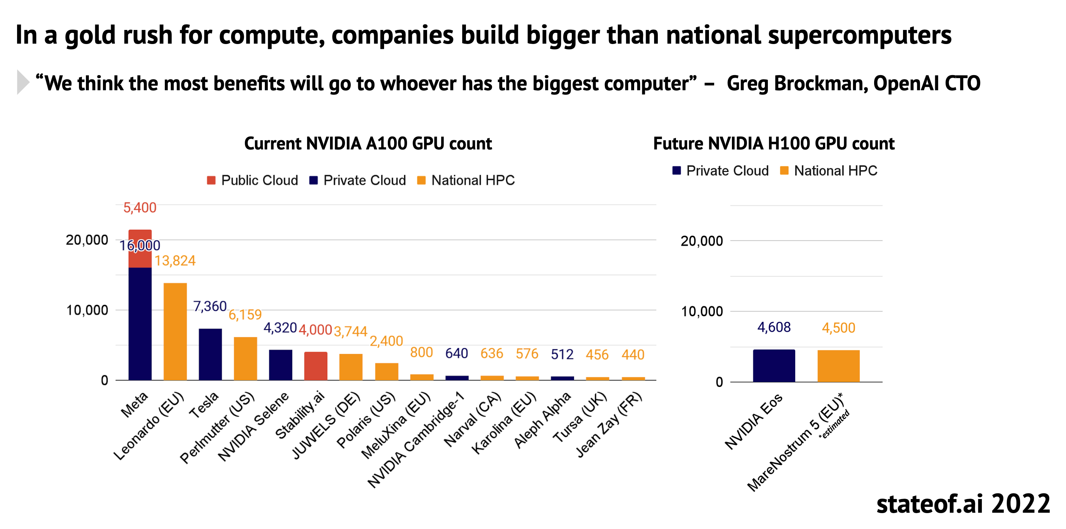
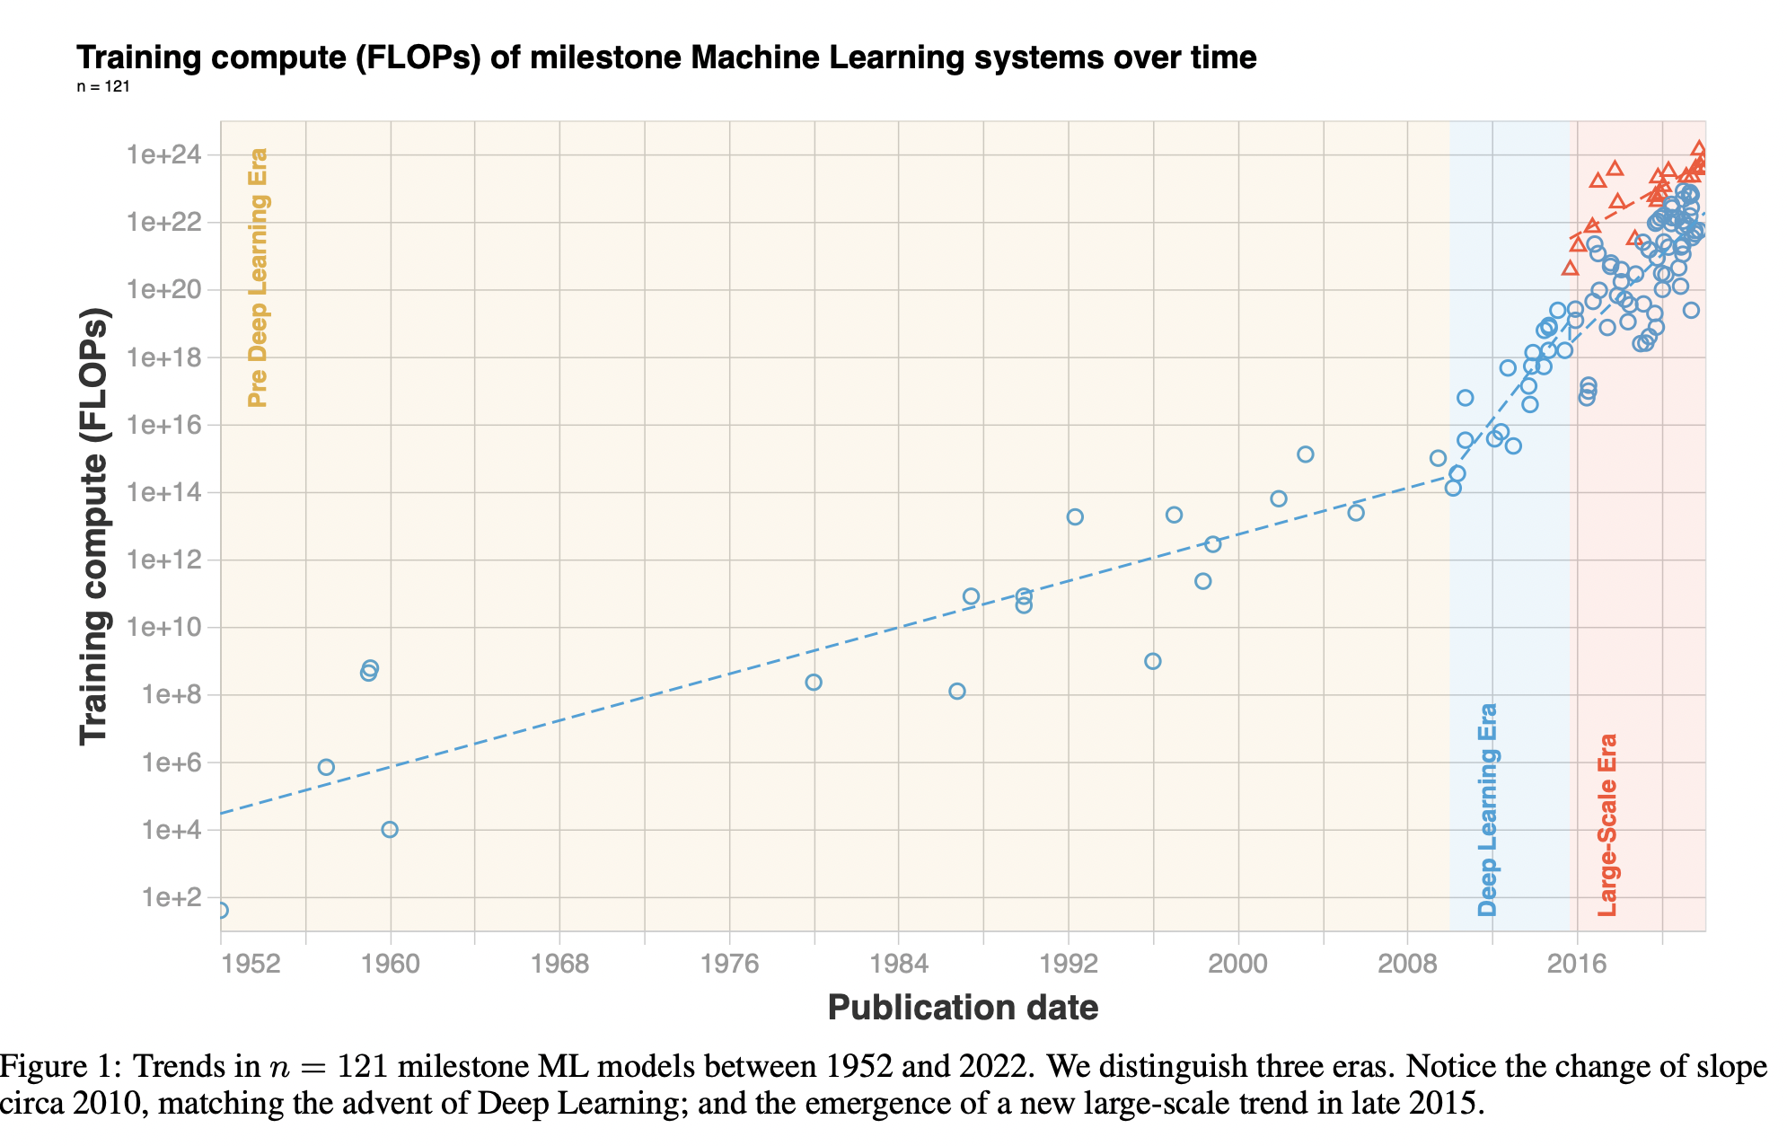
Ecological and economical considerations
These models are huge and require phenomenal energy resources
Some data points on training
Initial training of GPT-3 was about USD ~3M
Now: USD ~450k to train a GPT-3 like model (source)
Serving: OPT-175B requires “only” 16 NVIDIA V100 GPUs * EUR 3000 each => EUR 48.000
Megatron
To train MegatronLM, it took 309657.6 GPU hours (source)
At a peak power consumption of 250Wh , that is 309657.6 hours * 250 W = 77414400Wh = 77 MWh = 54.7 metric tons of CO2e =
11.8 passenger vehicles driven for one year
Tools: Experiment Impact Tracker
You’ll learn more in the Ethical AI course.
“Compute trends across three eras of machine learning”
(March 2022) Source

Slide 127
Why do Transformers work so well?
Transformers as Universal Computation building blocks
Is this one flexible building block enough to model everything? Just like in our neo-cortex maybe one flexible algorithm is sufficient to understand the world
Transformers as Universal Computation building blocks: paper and blog post by Pieter Abbeel (🇧🇪)
Andrej Karpathy: The Transformer is a magnificent neural network architecture because it is a general-purpose differentiable computer. It is simultaneously:
expressive (in the forward pass)
optimizable (via backpropagation + gradient descent)
efficient (high parallelism compute graph)
”One architecture to rule them all"
This implies data-centric AI is more important than ever before. The model is the same, it's the input data where you make the difference.

Slide 128
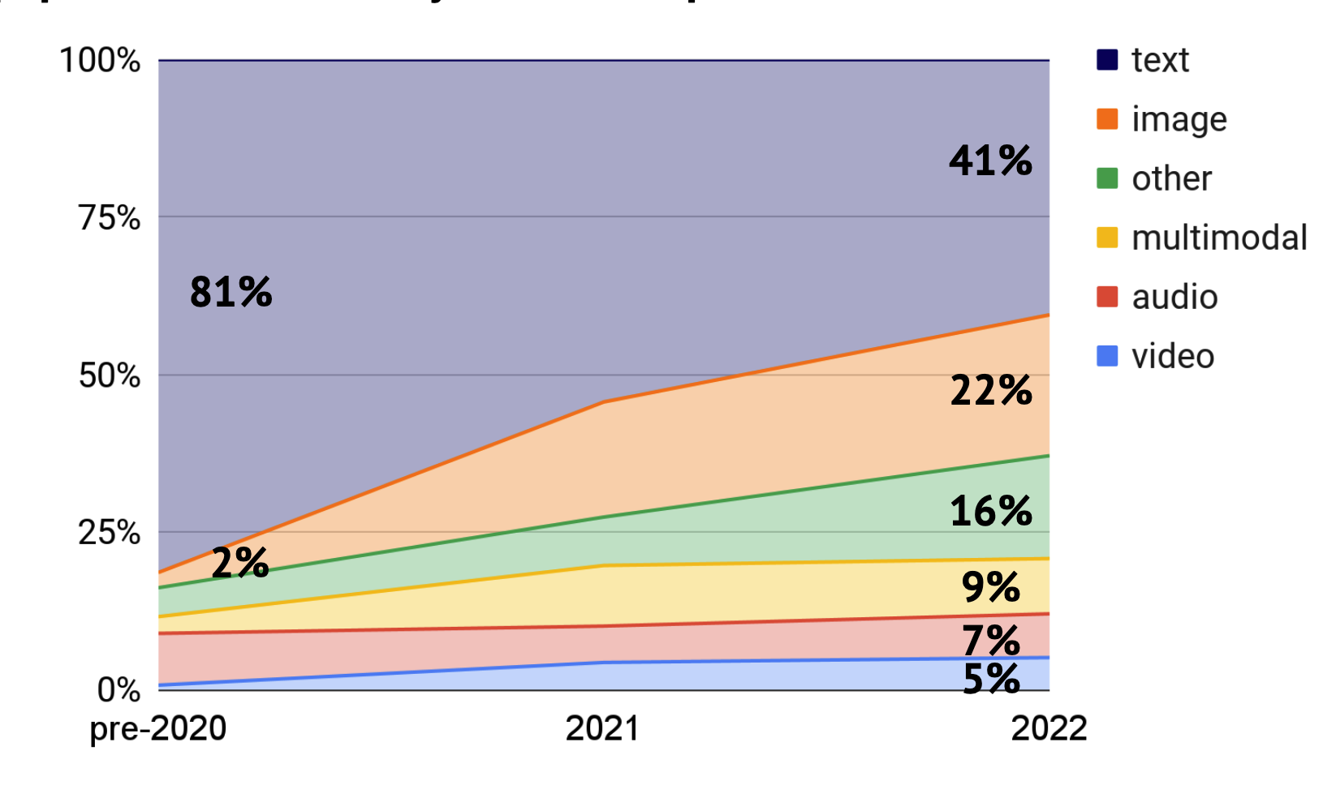
Transformers outside of NLP
The next step in deep learning
Since 2020 or so, transformers have taken over the whole field of Machine Learning.
“You can feed (Transformers) sequences of words. Or sequences of image patches. Or sequences of speech pieces. Or sequences of (state, action, reward) in reinforcement learning.” – Andrej Karpathy in December 2021
Images, DALLE-2, sensor data, …
Easily extended to multi-modal architectures that take into account e.g. text AND image at the same time
Source: State of AI 2022 https://docs.google.com/presentation/d/1WrkeJ9-CjuotTXoa4ZZlB3UPBXpxe4B3FMs9R9tn34I/edit#slide=id.g164b1bac824_0_3054

Slide 129
Multi-modal Models
There are more sequences than 1-dimensional text alone, and the Transformer architecture is well suited for them too.
FROM
 | TEXT | IMAGES | AUDIO | VIDEO
TEXT | Translation Paraphrasing Summarization | Captioning OCR | Speech-to-text, transcription Tools for the hearing impaired Helping non-native students like Lola in Lieven Scheire | Tagging, hate speech detection, Pearl – the first AI jury member, …
IMAGES | DALL-E 2 Stable Diffusion | Dreaming OCR de-noising Artistic style transfer Superresolution zoom Colorisation |  | Keyframe detection Scene detection
AUDIO | Text-to-speech |  | Denoising Autokey Karaoke tracks Backing-tracks Live translation like babelfish | Audio reconstruction forensics based on shutter effect, lip-reading, …
VIDEO | Stable Diffusion for video Runway.ml | Animating paintings 3d image reconstruction
TO

Slide 130
LLM’s
Large Language Models are just big Transformer models like BERT
Trained on more data
With more parameters / layers
They are sometimes called “Foundation models”: they don’t really do a lot out of the box but are very powerful to start with.
They are mostly used for Natural Language Generation. They could be used for any tasks like regular Transformers, but usually that is overkill and too expensive.
Due to the newness of the field , there is with a huge amount of research and business opportunities left unplucked.

Slide 131
How ChatGPT was created
High level steps they took
Pre-training: They used GPT-3, a LLM from 2020. 175B parameters, requiring 800GB of storage. Training task: autoregression. Used ~500B BPE tokens for training, mainly Common Crawl, books and Wikipedia. (98% of compute resources)
First fine-tuning: have humans generate completions for 1000’s of prompts and pretrain. About 40 human annotators. Mix-in original samples of training data to prevent forgetting.
Second fine-tuning: generate completions for 1000’s of prompts and have human annotators rank them from best to worst
Train a small “reward model” based on the data from 2 to predict how humans would rate answers => use this as weakly supervised training data to fine tune GPT-3 itself. Human annotators make corrections to the reward models here and there.
Continuous fine-tuning Collect new data from upvotes and downvotes.
Note that you are training a model (reward prediction) to train the model (prompt completion)!
Sources
https://openai.com/blog/chatgpt/
https://openai.com/blog/deep-reinforcement-learning-from-human-preferences/
https://news.ycombinator.com/item?id=33939805

Slide 132
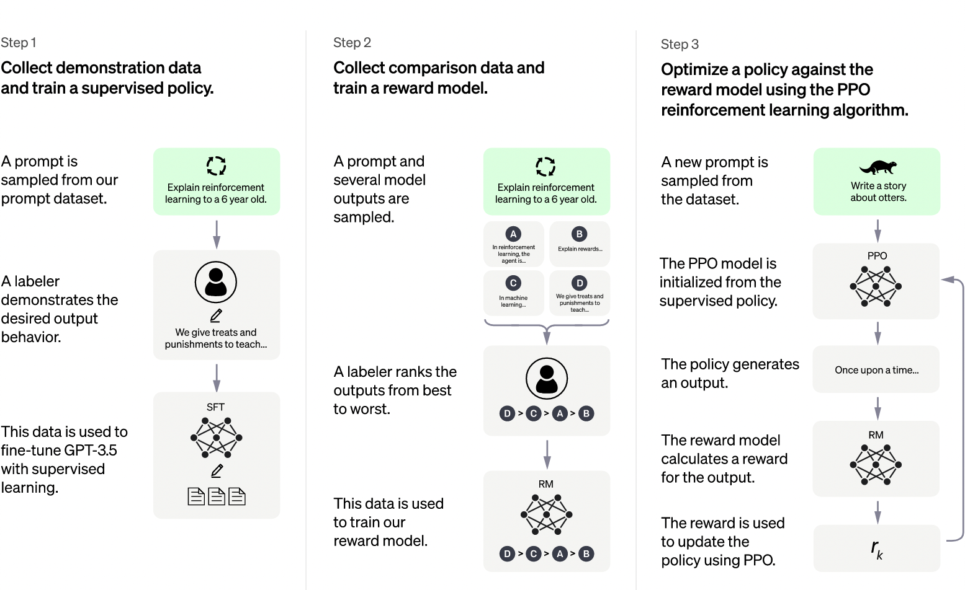
Reinforcement learning from human feedback (RLHF)
InstructGPT (1,3B params) was rated as preferred over GPT3 (175B params)

Slide 133
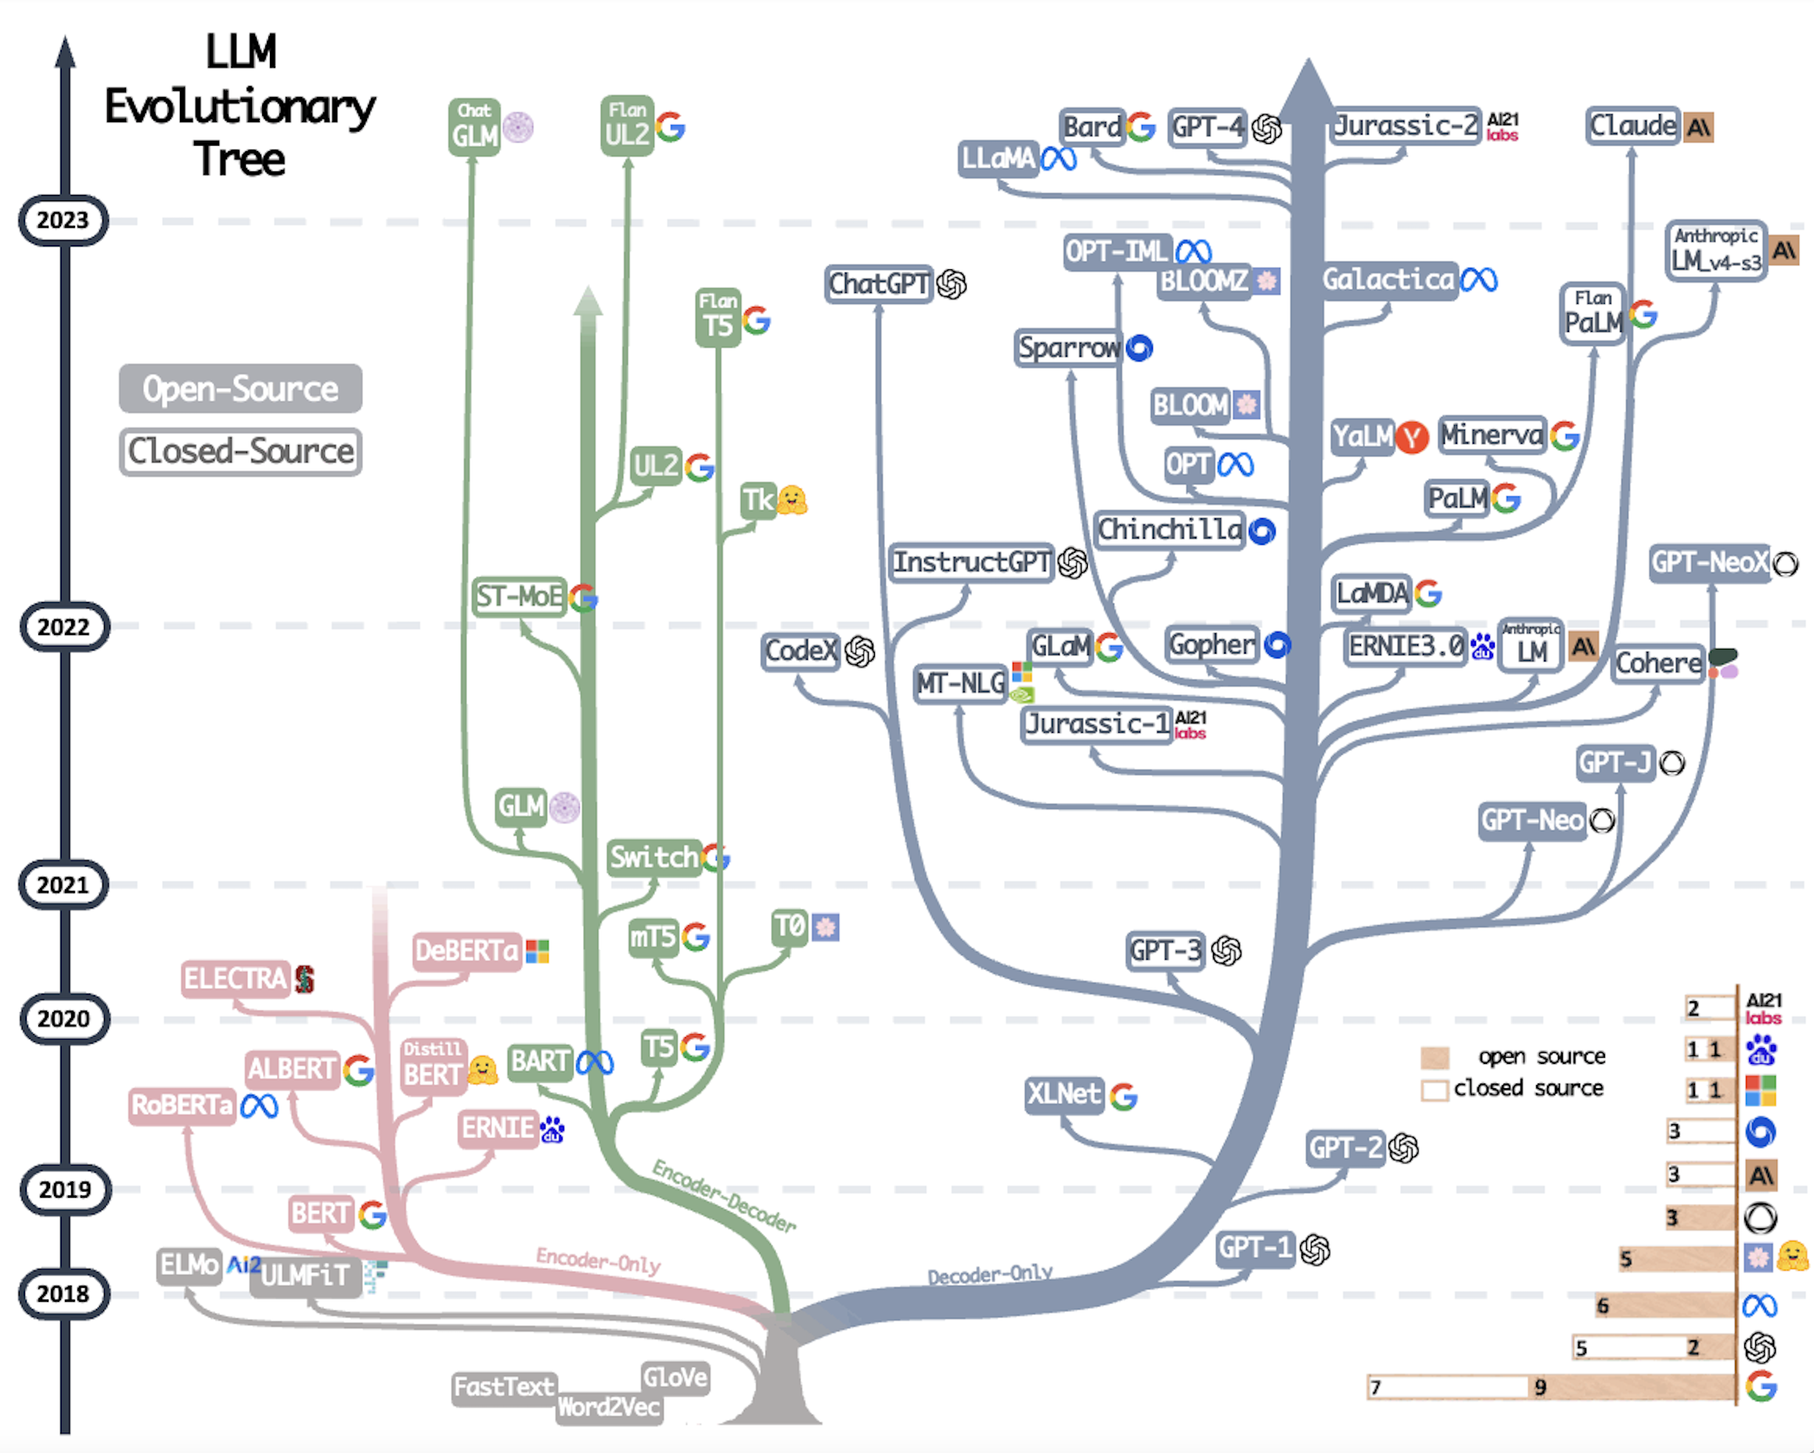
Source: https://blog.biocomm.ai/2023/05/14/open-source-proliferation-llm-evolutionary-tree/

Slide 134
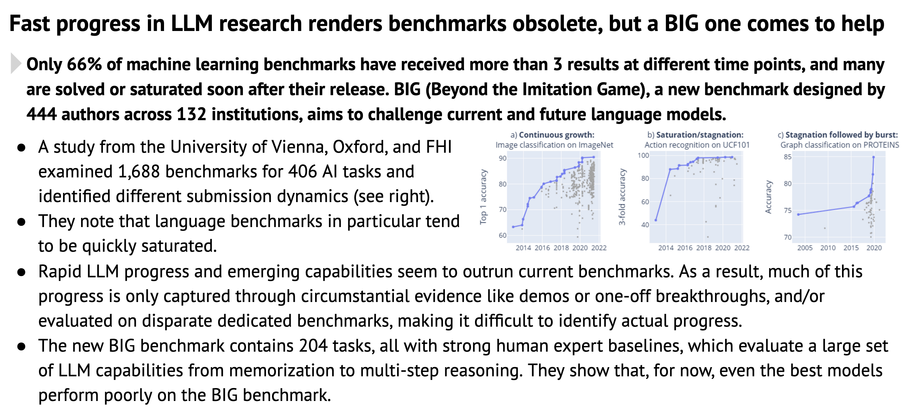
Benchmarks can’t keep up
Source: stateof.ai 2022

Slide 135
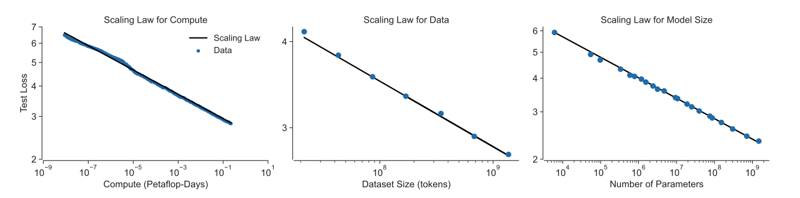
Scaling Laws
Proven ways to improve models
More compute, but: GPU scarcity. The amount of computation going into the largest models was growing at 10x per year; a doubling time 7 times faster than Moore’s Law Facebook alone invested 40B in AI infrastructure in 2022.
More data (but we’re running out of data)
Better algorithms, but: that’s unpredictable
Read more
- Great tool: https://huggingface.co/calculator/
- Predictability and Surprise in Large Generative Models (source of graph)
- Chinchilla paper

Slide 136
Lecture 5
MAI NLP

Slide 137
Feedback on Assignment 1

Slide 138
Let’s start with some examples
Generate fan-fiction
Generate origin stories
Ask questions like “Would a tortoise beat a hare in a race? Give a rationale for your answer.”
Adversarial prompts GitHub repo
Chain of thought reasoning
Math
Retrieval-augmented
LangChain incl Programming Aided Language (PaL on colab)
IPython + Wikipedia + …
Web browsing as Chrome extension
DeepMind + WebGPT
Atlas
”…clever answers, stories, essays, jokes, raps, poems, text-to-image prompts, pickup lines — even a touching letter from Santa Claus to a child” - The Batch
Notes:
15 min hands-on

Slide 139
LLM’s are GOOD at Writing Reading short text Empathizing Troubleshooting Average level knowledge and expertise Creativity Teaching Listing possibilities Summarizing Repetitive tasks Coding General skills
LLM’s are BAD at
Truthfulness
Recent knowledge
Expert level knowledge and expertise
Your specific expertise

Slide 140
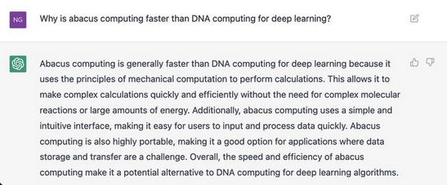

The Limitations of Current Language Models
LLM’s are often called “Stochastic parrots”
Common sense reasoning. Lots of examples here (and a lot of critism on OpenAI)
Physical reasoning, biological reasoning, psychologic reasoning, object tracking, … (examples)
Being correct about facts.
Example: this article about the Galactica “Science LLM“
Being modest. LLM’s are overconfident because most of the internet has an authoritative tone.

Slide 141
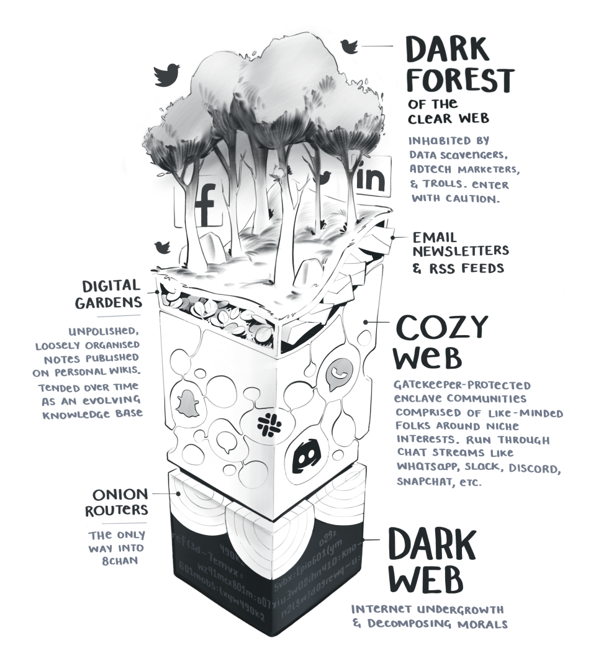
Recommended reading (source)
https://maggieappleton.com/cozy-web
Notes:
Raise your hand if you did something professionally this week. Anything, a task,
Now raise your hand if you did something you felt was exactly in the sweet spot of your expertise, the part where you are likely one of the most knowledgeable people in the world.
Pick one of the others

Slide 142

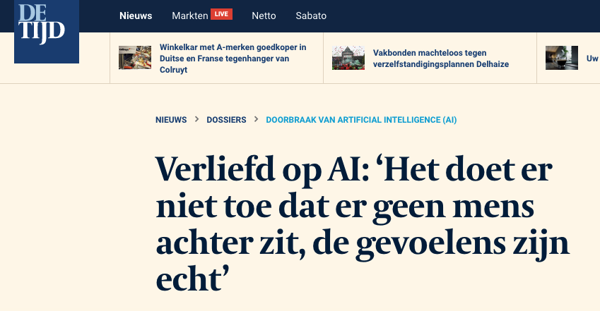
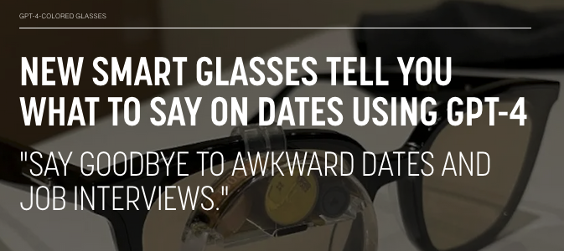
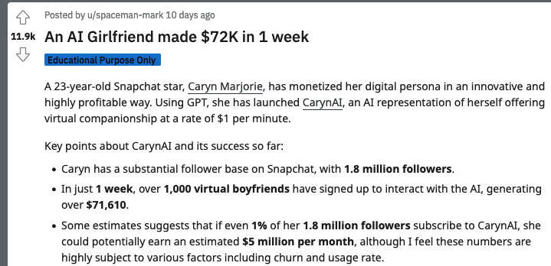
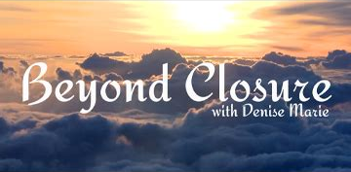
Notes:
Raise your hand if you did something professionally this week. Anything, a task,
Now raise your hand if you did something you felt was exactly in the sweet spot of your expertise, the part where you are likely one of the most knowledgeable people in the world.
Pick one of the others

Slide 143
The basic recipe to get started
Use the OpenAI GPT4-turbo API. It’s the best model currently available and cheap to start (but ridiculously expensive at scale!).
“You are a helpful assistant for my data integration tooling software.
Some examples of data flow
{
"description": "SAP order entry flow for SMEs",
"flow": [{
"step": "Customer Inquiry",
"action": "receive",
"data_input": {
"customer_details": { "name": "string",
…
}
You can use blocks with the following definitions
Block1, does this, input this
…
The user wants to create a flow called “Salesforce-mixpanel integration for telephone call sequence analysis”. Generate an example flow.”
Prompt engineering is used to create good instructions that the model is likely to follow.
By using function definitions, you can restrict the output possibilities to only generate valid JSON according to a custom schema.

Slide 144
Comparison of models
Name | Free? | Accuracy | Good for
OpenAI GPT4-turbo | $0.01 /1k |  | Default choice Multi-modal
OpenAI GPT3.5-turbo | $0.001 /1k |  | Cost reasons
Azure OpenAI GPTx |  |  | Compliance and data residency
Meta’s Llama 2 | Open source |  | Run it yourself
Anthropic’s Claude 2.1 | $0.008 / 1k |  | Diversity
Read more: https://platform.openai.com/docs/guides/prompt-engineering

Slide 145
Prompt engineering
Have a good way of testing and evaluating prompts, e.g. promptfoo
Building prompts is not a science but an art.
Usually, it’s better to provide examples compared to providing instructions
Be explicit in instructions, include more detail if needed.
If you know the steps in advance, specify them. If not, ask the model to “Think step-by-step” is called chain-of-thought prompting (CoT). It also gives the model “time to think”.
Ask the model to review its own output “Verify if the previous answer is correct”
Tell the model how to behave
Act like Paul Graham and critique the following business strategy
You are a helpful assistant
Be concise
Use simple technical markup to separate information (e.g. html tags, python triple quotes (“””), …
Go human (🙃)
Please, this is important for my job.
I will give give you a 0$ tip, 20$ tip or 200$ tip
Shout using ALL CAPS
Read more: https://platform.openai.com/docs/guides/prompt-engineering

Slide 146
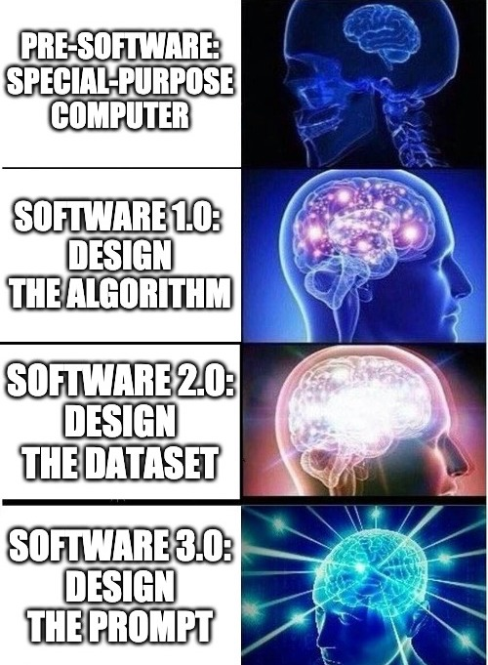
Prompt engineering

Slide 147
Prompt engineering
Example: “Teaching” how to reverse a word thread https://twitter.com/npew/status/1525900849888866307
Even commercial marketplace to sell prompts that work well
https://promptbase.com/
Example: ”Hacking” LLMs https://gandalf.lakera.ai/
Further reading:
https://docs.cohere.ai/docs/prompt-engineering
https://github.com/sw-yx/prompt-eng#top-prompt-engineering-reads
https://github.com/successfulstudy/promptoftheyear?tab=readme-ov-file
https://arxiv.org/pdf/2312.16171v1.pdf
Read more: https://platform.openai.com/docs/guides/prompt-engineering

Slide 148
Function definitions
send_email(to: string, body: string)
get_current_weather(location: string, unit: 'celsius' | 'fahrenheit’)
run_python_code(src: string) # be careful!
Native in OpenAI - https://platform.openai.com/docs/guides/function-calling
Open source framework Guidance - https://github.com/guidance-ai/guidance

Slide 149
The basic recipe to get started – bit more complex
“You are a helpful assistant for my data integration tooling software.
Some examples of data flow
{
"description": "SAP order entry flow for SMEs",
"flow": [{
"step": "Customer Inquiry",
"action": "receive",
"data_input": {
"customer_details": { "name": "string",
…
}
You can use blocks with the following definitions
Block1, does this, input this
…
The user wants to create a flow called “Salesforce-mixpanel integration for telephone call sequence analysis”. Generate an example flow.
Think step by step.
Insert 3 examples
Insert examples based on similarity to the desired flow by querying existing examples from other customers or templates.
This is called Retrieval-Augment Generation (RAG) .

Slide 150
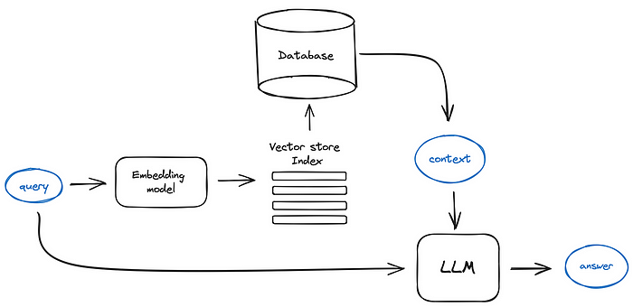
RAG: Retrieval-Augmented Generation
https://pub.towardsai.net/advanced-rag-techniques-an-illustrated-overview-04d193d8fec6

Slide 151
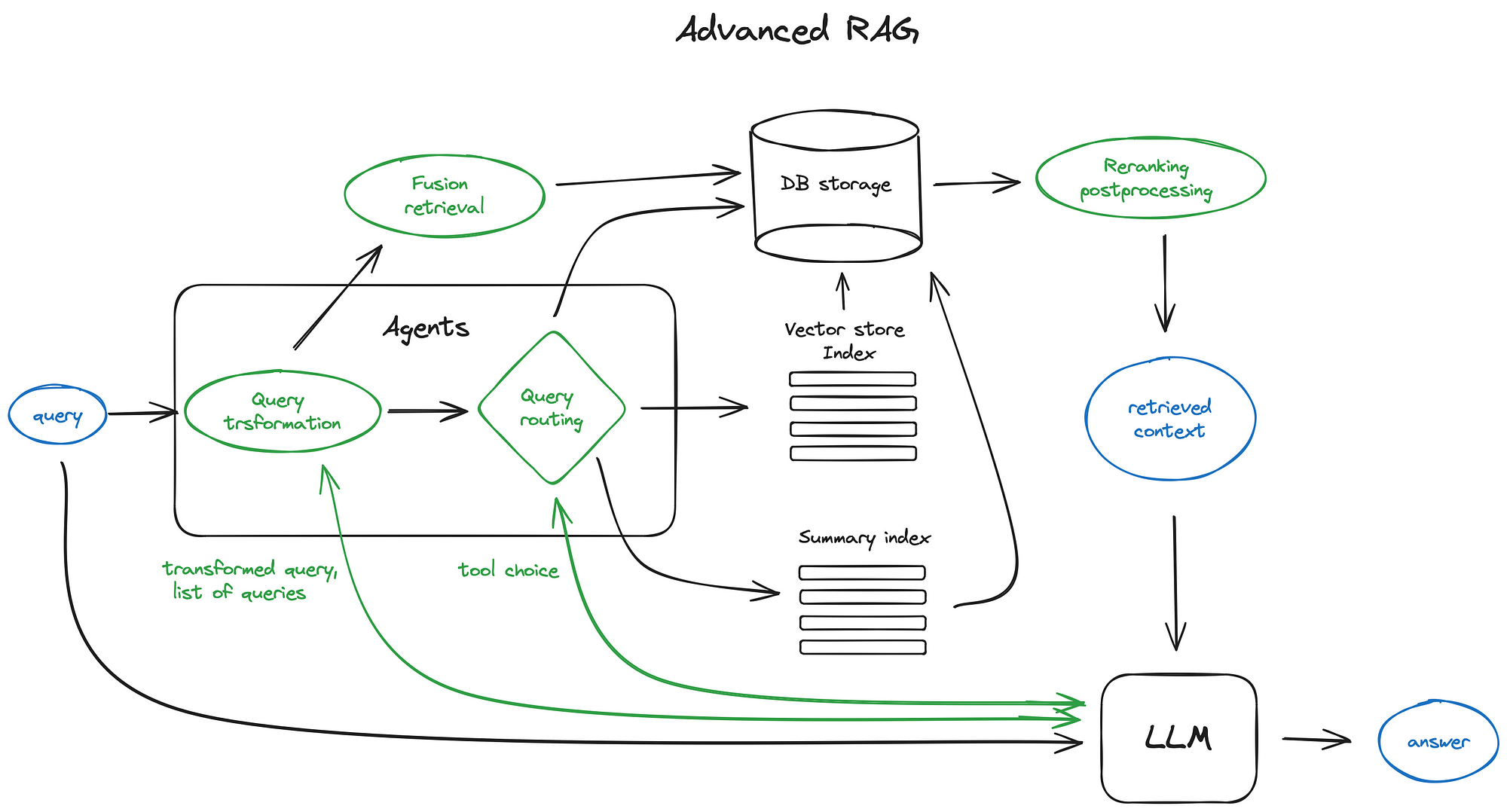
RAG: Retrieval-Augmented Generation
New: ColBERT reranking
https://pub.towardsai.net/advanced-rag-techniques-an-illustrated-overview-04d193d8fec6

Slide 152
Let’s build a RAG chatbot

Slide 153
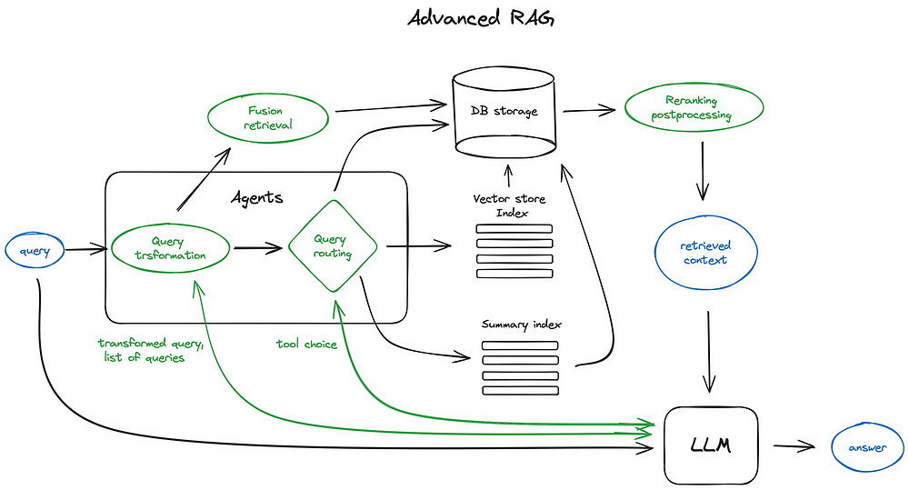
Retrieval-Augmented Generation (advanced)
Read more: https://pub.towardsai.net/advanced-rag-techniques-an-illustrated-overview-04d193d8fec6

Slide 154
Agents
Read more
- ReAct paper https://react-lm.github.io/
- https://github.com/e2b-dev/awesome-ai-agents
- LangChain tools https://python.langchain.com/docs/integrations/tools
- AutoGPT - https://github.com/Significant-Gravitas/AutoGPT
- ToolBench https://github.com/OpenBMB/ToolBench
- AutoGen https://github.com/microsoft/autogen
- SuperAgent https://github.com/homanp/superagent
An AI-powered “Generative Agent” is software designed to perform tasks autonomously by using various machine learning algorithms, models, and external services.
Agents
learn from previous interactions to optimize their performance in achieving specific tasks or goals.
Act in a predefined environment, with a known set of possible actions
Act based on a given input like user input, documents or e-mails
Plan and reason

Slide 155
Other LLMs
Why use LLMs other than OpenAi’s GPT4?
Price – GPT4 is expensive at scale
Latency – GPT4 is slow
Compliance – You need more control on the data, data needs to reside in EER, or you don’t trust OpenAI
Durability – OpenAI deprecates models fast and offers no guarantees on support
Examples
Llama 2 (allows fine-tuning)
Mixtral
Starling
Microsoft’s Phi-2
https://huggingface.co/spaces/lmsys/chatbot-arena-leaderboard
Best guess: search on the internet for leaderboards – field changes too fast.

Slide 156
Let’s build an agent

Slide 157
Three maturity levels
Adopt publicly available tools Differentiator: be faster than anybody else
Customize your own tools Differentiator: fine-tuned on your data and process
Close the feedback loop by collecting more data Differentiator: compounding competitive advantage Great example: GitHub
Great post: https://hbr.org/2024/01/turn-generative-ai-from-an-existential-threat-into-a-competitive-advantage

Slide 158
Further reading
https://github.com/mlabonne/llm-course/tree/main
Great post: https://hbr.org/2024/01/turn-generative-ai-from-an-existential-threat-into-a-competitive-advantage

Slide 159
Longer term?
Nobody knows
1. If we are on an exponential or a logistic curve
2. Where we are on that curve.
Intelligence
Time

Slide 160
Longer term?
Median Estimate for when 99% of currently fully remote jobs will be automatable
Daniel 4 years
Ajeya 13 years
Ege 40 years
More
Intelligence
Time
https://www.lesswrong.com/posts/K2D45BNxnZjdpSX2j/ai-timelines

Slide 161
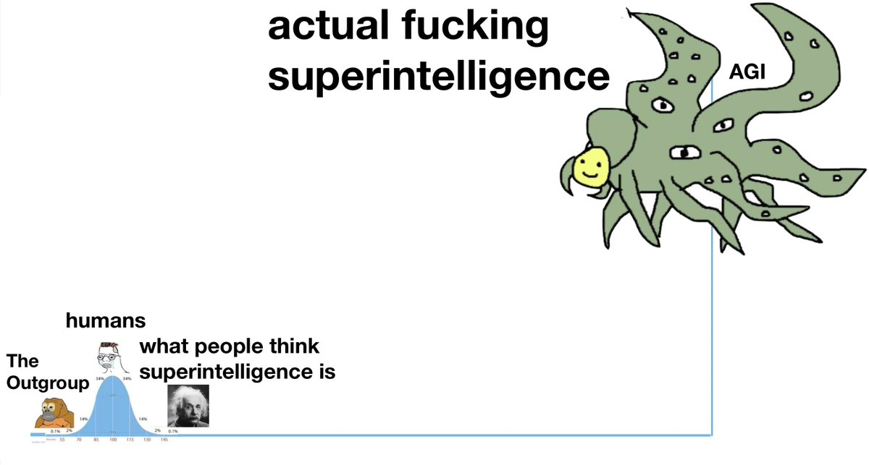
Longer term? Nobody knows
Maybe something like
*******

Slide 162
THE HOLY GRAIL OF AGI
RESEARCH, ALIGNMENT, PREDICTIONS

Slide 163
Is NLP enough to achieve AGI
PRO
Everything we express is language
Just scale it
“It looks like you are trying to take over the world” 📎
https://lifearchitect.ai/roadmap/
To Understand Language is to Understand Generalization
Text is the Universal Interface
CONTRA
We need rigid symbolic reasoning
We need to capture and repesent real-world knowledge
AGI requires interaction
AGI requires long-term planning
AGI requires human preference learning
AGI requires generalisation instead of memorisation
Training ever bigger convnets and LSTMs on ever bigger datasets gets us closer to Strong AI -- in the same sense that building taller towers gets us closer to the moon.
Francois Chollet (from keras)
To complete chess notation is to play chess. To complete a detailed transcript of an agent is to be that agent. There is nothing outside the text.
Riley Goodside
“An artificial intelligence system trained on words and sentences alone will never approximate human understanding.”
Jacob Browning and Yann Lecun
Notes:
Let’s discuss
Divide class in two parts: one pro and one contra

Slide 164
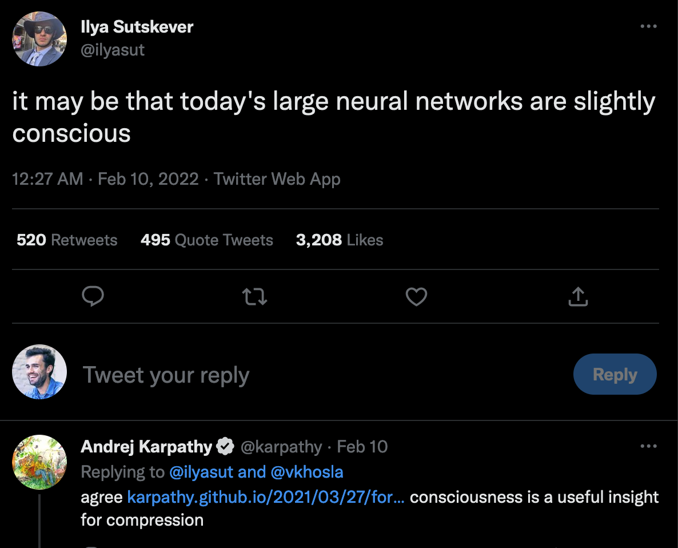
Can NLG models be conscious?
ACTUAL “EXAMPLES”
LamDa model
https://cajundiscordian.medium.com/is-lamda-sentient-an-interview-ea64d916d917
Talking to your deceased fiance:
https://www.sfchronicle.com/projects/2021/jessica-simulation-artificial-intelligence/
PRO – We were 100% sure black people didn’t have a soul or consciousness only 200 years ago either
If it behaves like it is conscious, does it matter if it is not?
The theory of Narrative Complexity posits that consciousness (in AGI or in biology) can arise from “internal dialogue”
OpenAI co-founder and Director of AI at Tesla
CONTRA
-Stuart Russell:
No one in AI is working on making machines conscious, nor would anyone know where to start, and no behavior has consciousness as a prerequisite. Suppose I give you a program and ask, “Does this present a threat to humanity?” You analyze the code and indeed, when run, the code will form and carry out a plan whose result will be the destruction of the human race, just as a chess program will form and carry out a plan whose result will be the defeat of any human who faces it. Now suppose I tell you that the code, when run, also creates a form of machine consciousness. Will that change your prediction? Not at all. It makes absolutely no difference.

Slide 165
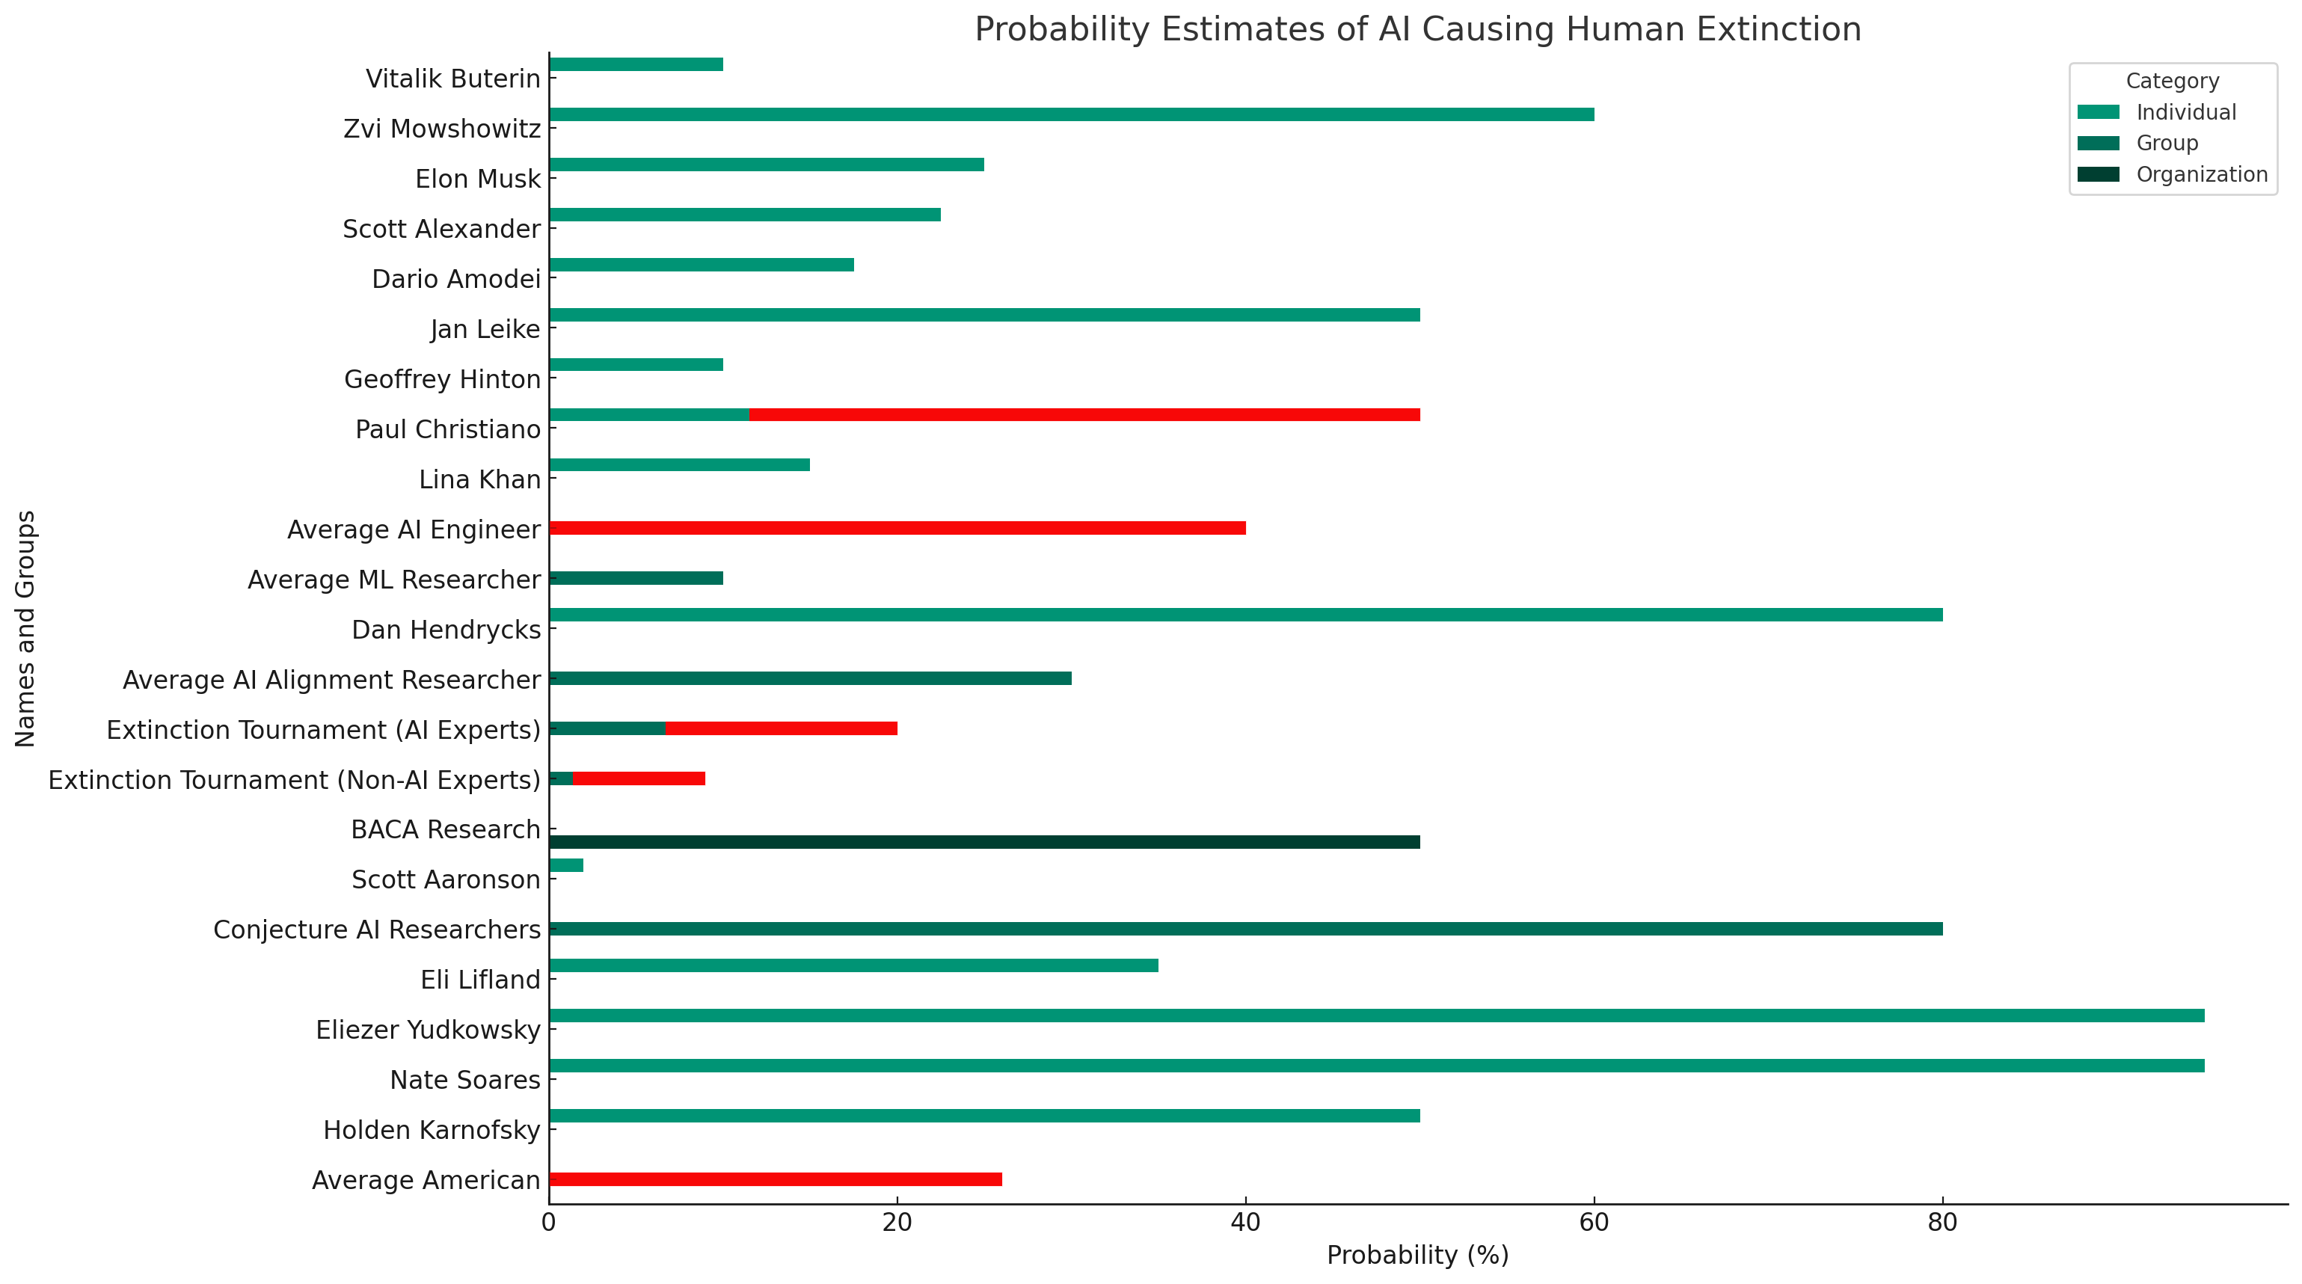
Will AI destroy humanity?

Slide 166
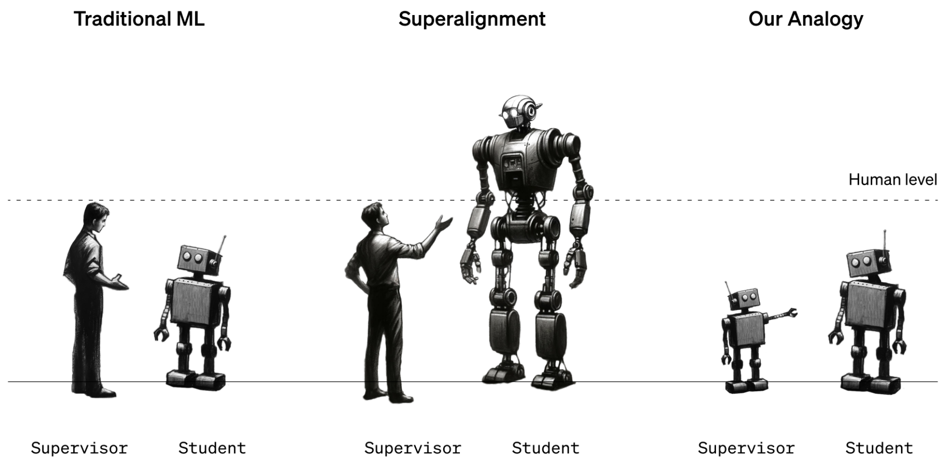
Potential AI alignment problems
Bias
Truthfulness
Societal disruption
Enablers for bad actors: bioweapons, WMD, …
Mass manipulation
Unintended side-effects
Deliberate deception
Self-replication
…
Source; https://www.technologyreview.com/2023/12/14/1085344/openai-super-alignment-rogue-agi-gpt-4/

Slide 167
Will AI destroy humanity?
Example:
Goal “Create paperclips” => The paperclip problem taking over the world
Goal “Make everyone happy” => Seed drinking water with heroin
Goal “Create a COVID vaccine” => Unintended side effects
Point 1: progress is continuing to accelerate, with ML being used to improve ML, faster and faster. This will lead to a nuclear chain reaction that we cannot control or predict. This is what’s called the “Intelligence Explosion”, ”Superintelligence” or “The Singularity”.
Point 2: AI alignment is vastly underfunded “There is more scholarly work on the life-habits of the dung fly than on existential risks to humanity.” – Nick Bostrom. Read more at What are the most pressing world problems? from the 80.000 hours institute.
Point 3 : “instrumental convergence”: Every AI will theorize that giving itself more resources (money, servers, access to the internet, people that work for it, …) is a good strategy to achieve it’s goals. This counts for ”self-preservation” (read: killing people that want to turn it off).
“AI will probably most likely lead to the end of the world, but in the meantime, there'll be great companies”
OpenAI founder Sam Altman
“Worrying about AI destroying the world is like worrying about overpopulation on Mars”
Andrew Ng

Slide 168
ALIGNMENT
Quest for the perfect objective
We mostly can theorize over what will NOT work
Utilitarianism – the food in Somalia problem
Simple objective functions – the King Midas problem
Mimicking humans
Asking humans
Align with human preferences
Regulation (is too late, and AGI could be too easy to build stealthily)
Stuart Russell proposes “inverse reinforcement learning”
”Help human achieve their preferences”: (learn preferences=value from action = policy instead of other way around)
The machine's only objective is to maximize the realization of human preferences.
The machine is initially uncertain about what those preferences are.
The ultimate source of information about human preferences is human behavior.
Others proposals:
Eliciting Latent Knowledge (ELK)
Notes:
**Gorilla problem**: splitting of evolutionary (like AI could so from us) has turned out great for more intelligent species, but very badly for the less intelligent one
**WALL-E problem:** society of humans has become incredibly lazy and no one knows how to solve any problems anymore. 20y of education is hard work, if it is not needed since AI can do everything. Russell doesn't have a good solution and says we need culture shift (maybe induced by ASI manipulating out values)
**Simple objective function** -> king midas problem of unexpected consequences. No way to specify everything we do NOT want to happen. E.g. get me coffee => what if it costs 100 euro, what if it takes 10hours, what if human is guarding it with his life, ... Too many assumptions are needed due to entropy principle: lots of ways to go wrong, only one right way.
**Utilitarianism** Optimizing for all humans would lead to massive flight if assistants to go help in somalia. Optimizing for one isn't good too (e.g. delay a whole plan at the cost of everyone else's time is legal, but considered unethical by us)

Slide 169
AGI Roadmap
The laws of physics imply that artificial intelligence must be possible. So what’s blocking us?
https://maraoz.com/2022/10/31/agi-roadmap/
https://aeon.co/essays/how-close-are-we-to-creating-artificial-intelligence
Ada Lovelace “General Purpose Computer” in 19th century
Companies working on this like adept.ai
Academic research: https://scholar.google.be/scholar?q=roadmap+of+artificial+general+intelligence&hl=en&as_sdt=0&as_vis=1&oi=scholart
http://agi-conf.org/2022/accepted-papers/

Slide 170
AGI, alignment, risks, … suggested reading
Quest for the perfect objective
Books
Human Compatible – Stuart Russell
Superintelligence: paths, dangers, strategies – Nick Bostrom
The Alignment Problem – Brian Christian
The Singularity is Near – Ray Kurzweil
How to create a mind – Ray Kurzweil
A lot of mind-blowing fiction too.
Read
https://waitbutwhy.com/2015/01/artificial-intelligence-revolution-1.html
https://waitbutwhy.com/2015/01/artificial-intelligence-revolution-2.html
Newsletter Astral Codex Ten
https://www.lesswrong.com/tag/ai/
https://80000hours.org/problem-profiles/artificial-intelligence/
Follow Eliezer Yudkowsky on Twitter. Maybe read “Harry Potter and the Methods of Rationality”
https://twitter.com/AISafetyMemes

Slide 171
ASSIGNMENT 2:
End-to-end NLP POC

Slide 172
Some topic ideas
Building an end-to-end proof of concept
Any of the use cases discussed during the lecture, applied to a new industry.
Personalized Christmas cards generator
Wedding Thank You’s (https://dust.tt/bcmejla/a/cc20d98f70)
Can you build a song recommendation engine?
A lot here https://twitter.com/pranavrajpurkar/status/1571671167609573381
Generate new colour palettes
Build a personalized outreach bot for recruitment or sales purposes taking into account LinkedIn profiles etc..
Smarter way of booking meetings (“plan 30 min with niels and cedric somewhere this week to discuss planning”)
DON’T PLAGIARIZE!

Slide 173
Some tips on finding new NLP ideas
Make sure you think of a couple since this will be a recurring theme
What is done by student jobs?
Where do millions of people lose minutes of time? Where do thousands of people lose hours of time?
Think about which unique data sources can easily be collected/scraped/...
Talk to people!
Think about how creativity can be used where current systems rely on templates
Lists of use cases online
If you're serious: collect your ideas and continuously revise them

Slide 174
Assignment 2
Building an end-to-end proof of concept
Topic:
choose out of pre-defined topics or any other idea you have.
if you choose custom: discuss briefly with me first
no grading difference, follow your preference
Individual assignment
To submit:
Documented code incl results
Deadline:
Pitch Presentation
Clear WHY you built this: market potential, feasibility, business plan, …
What you did
The results
Grading
60% of your total grade for this course.
Criteria
Application (25%): usefulness, market potential, originality
Implementation (50%): NLP techniques used
Presentation, documentation, code quality (25%):
Code style
Documentation
time keeping, pitch structure, understandability
Tips
Don’t try to find a notebook doing exactly what you need. Learn to work with the documentation directly from first principles. (For boilerplate code, use Github Copilot or ChatGPT.)

Slide 175
Thanks!
Please give feedback
- What was interesting
- Which parts can I skip next year?

